Slide 1
Fei Hou, Susie Bai, Sidi Liu
Enron Internal Email Network

Slide 2
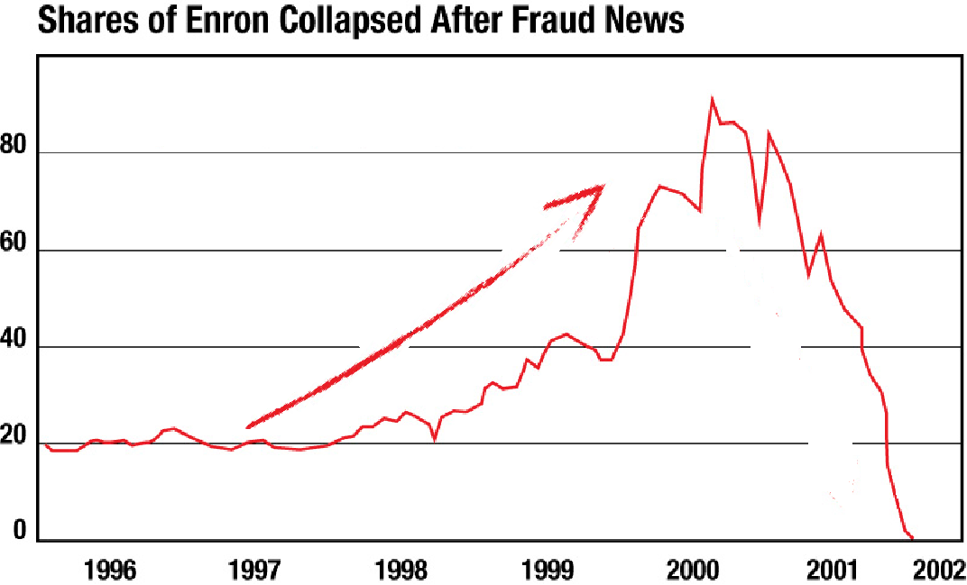
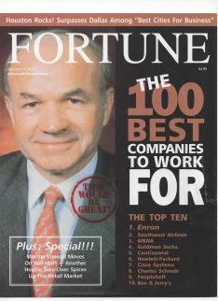
America's most innovative company
America's seventh largest company in 2001
$100B in annual revenue

Slide 3
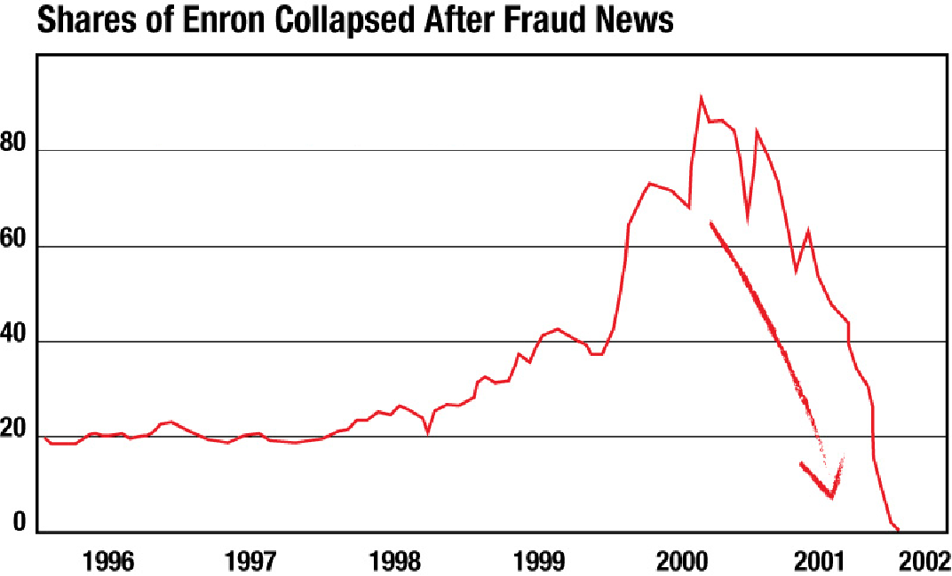
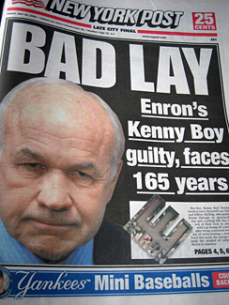
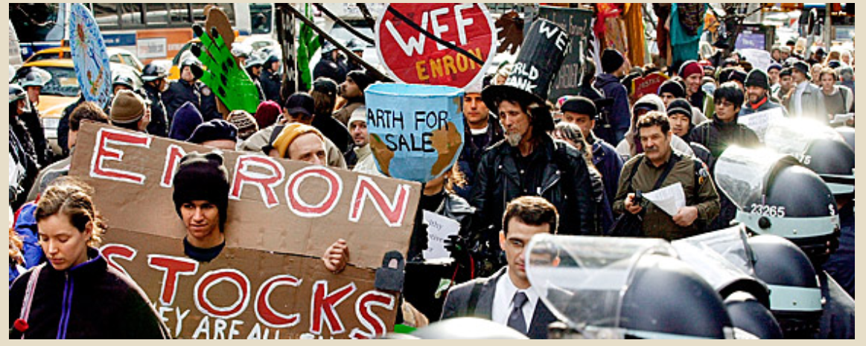
Corporate corruption and accounting fraud
Nearly 100,000 people lose their jobs
CEO was sentenced to prison

Slide 4
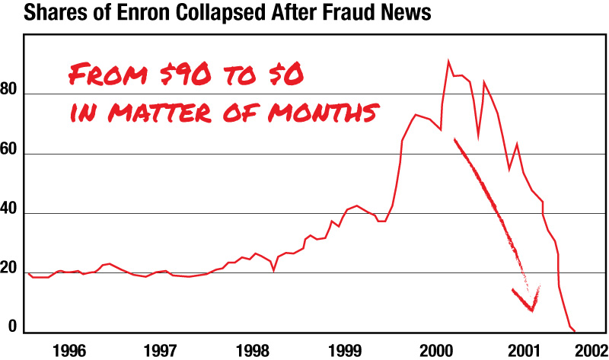
WHAT HAPPENED?

Slide 5
Is there any indication of collapse of Enron beforehand?
What are some characteristics of this email network before and after the “crisis point” of Enron?
Research Question
Notes:
1:30

Slide 6
500,000+ emails from 150 employees’ computers of the Enron Corporation, inspected for their possible misbehavior during the scandal, from October, 1998 to June, 2002.
280000+ “TO” types of email
47383 “CC” and “BCC” types of email respectively
It contains employee info data from about 150 users, mostly senior management of Enron → 10 types of “Status”(Roles) on this employee list
It constitutes the largest public domain database of real world company emails in the world.
Data Description

Slide 7
Analysis and Insights

Slide 8
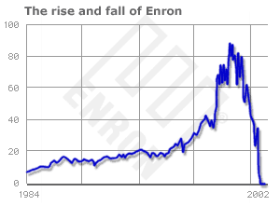
July 1985
Enron was formed
August 2000 - “Prime Day”
Enron shares hit all-time high of $90.56
October 2001 - “Crisis Point”
Enron reports a $618m loss and $1.2b reduction in shareholder equity
December 2001
Enron filed for bankruptcy
Recall the History: Key Timeline

Slide 9
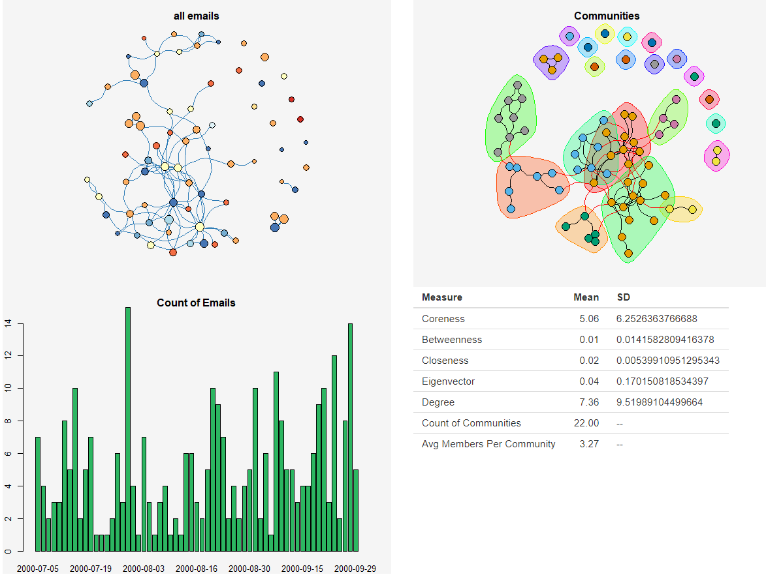
2000 Q3

Slide 10
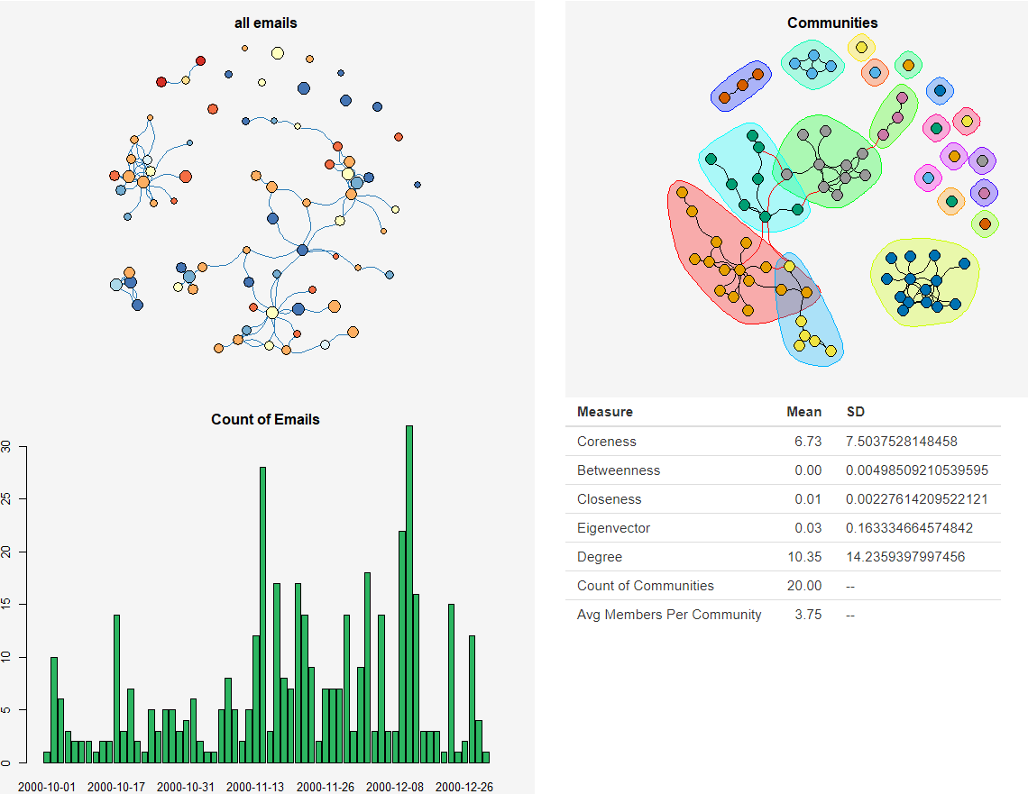
2000 Q4

Slide 11
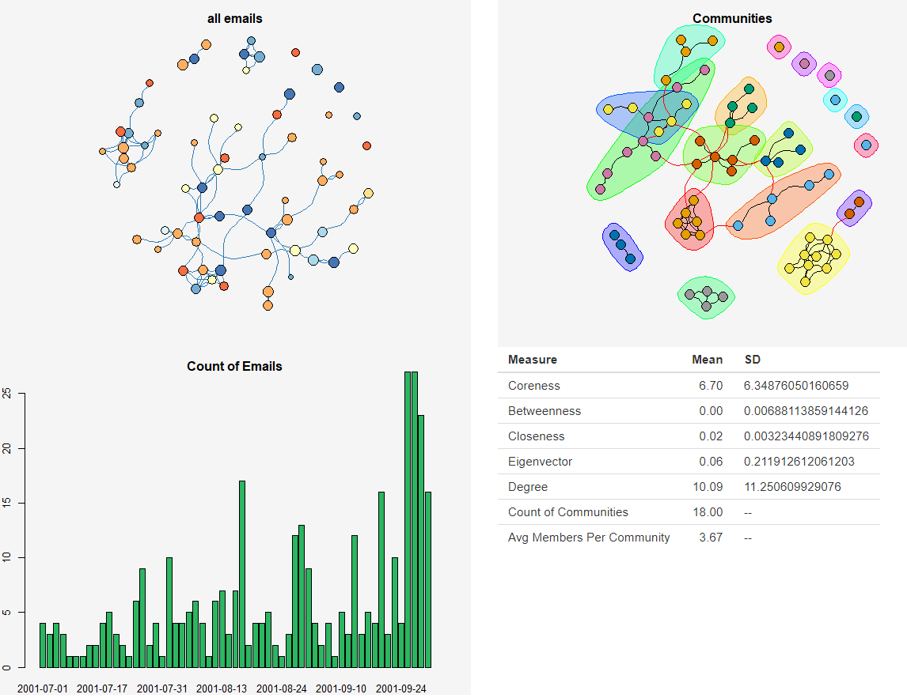
2001 Q3

Slide 12
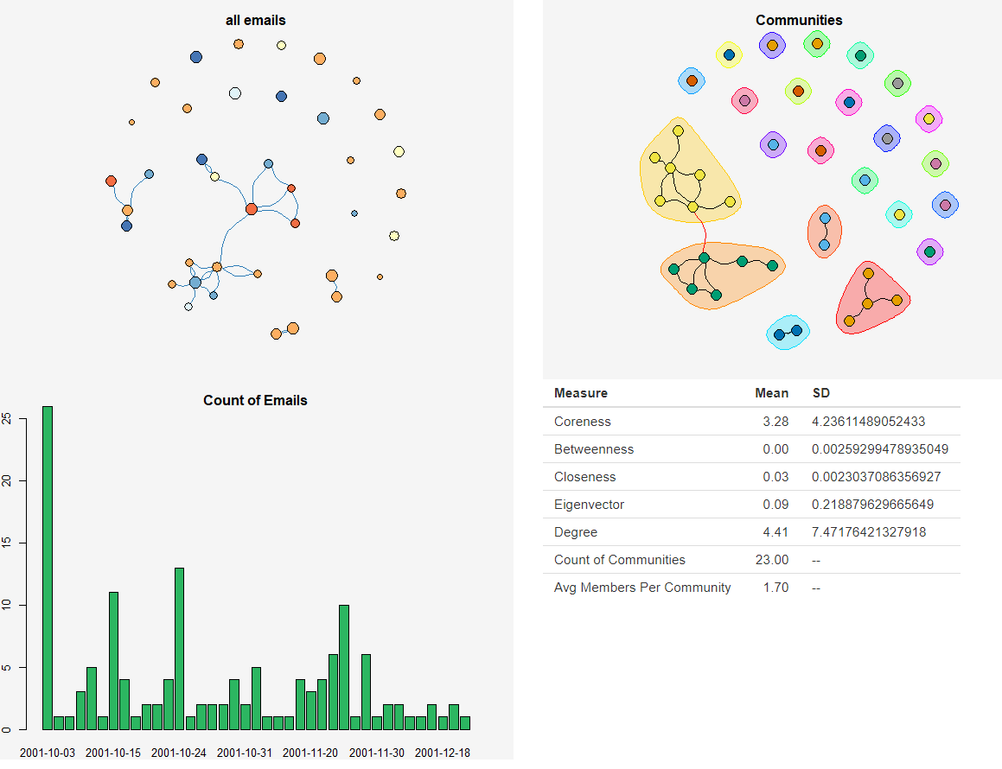
2001 Q4

Slide 13
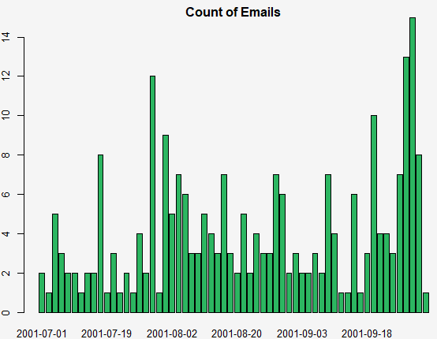
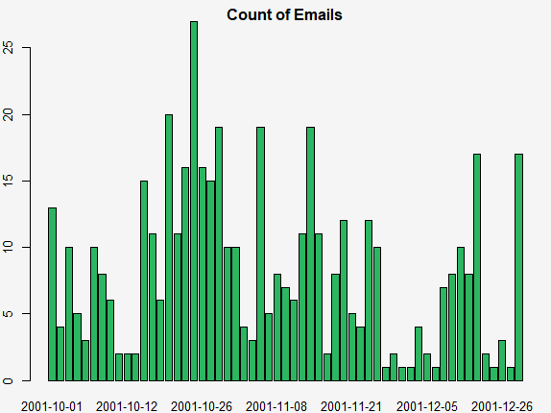
Amount of bcc emails
Before the crisis
After the crisis
Notes:
7:00

Slide 14
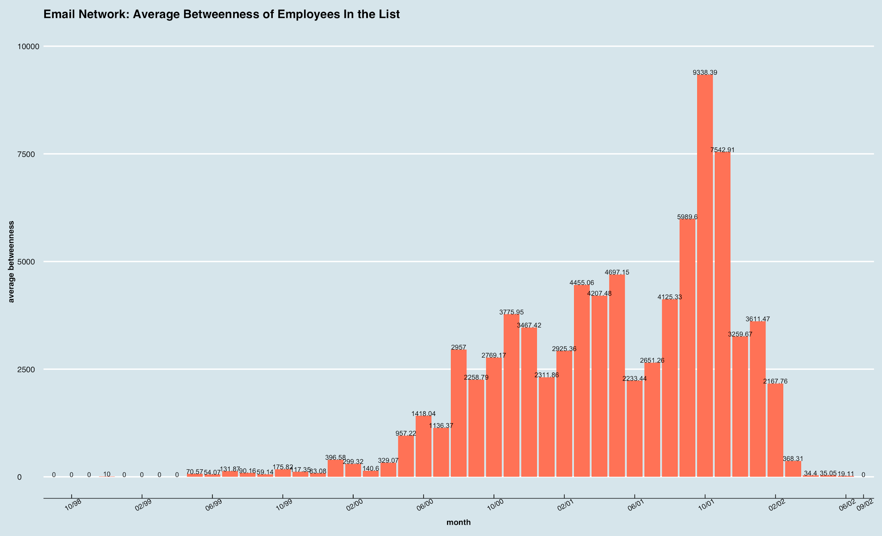
Descriptive Analysis for People “in the List” -- Average Betweenness

Slide 15
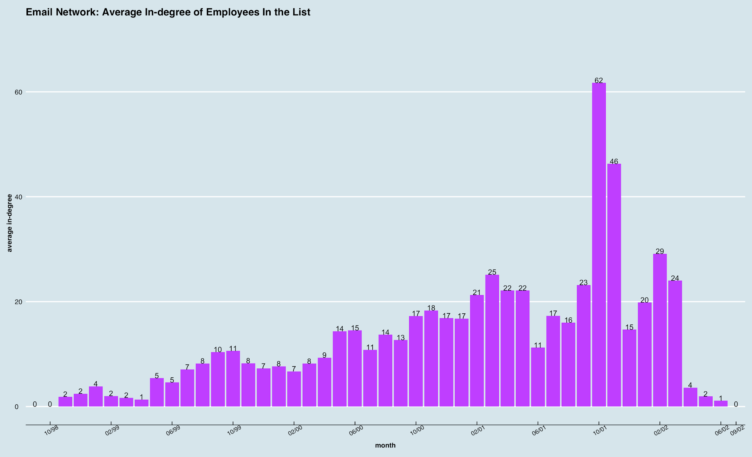
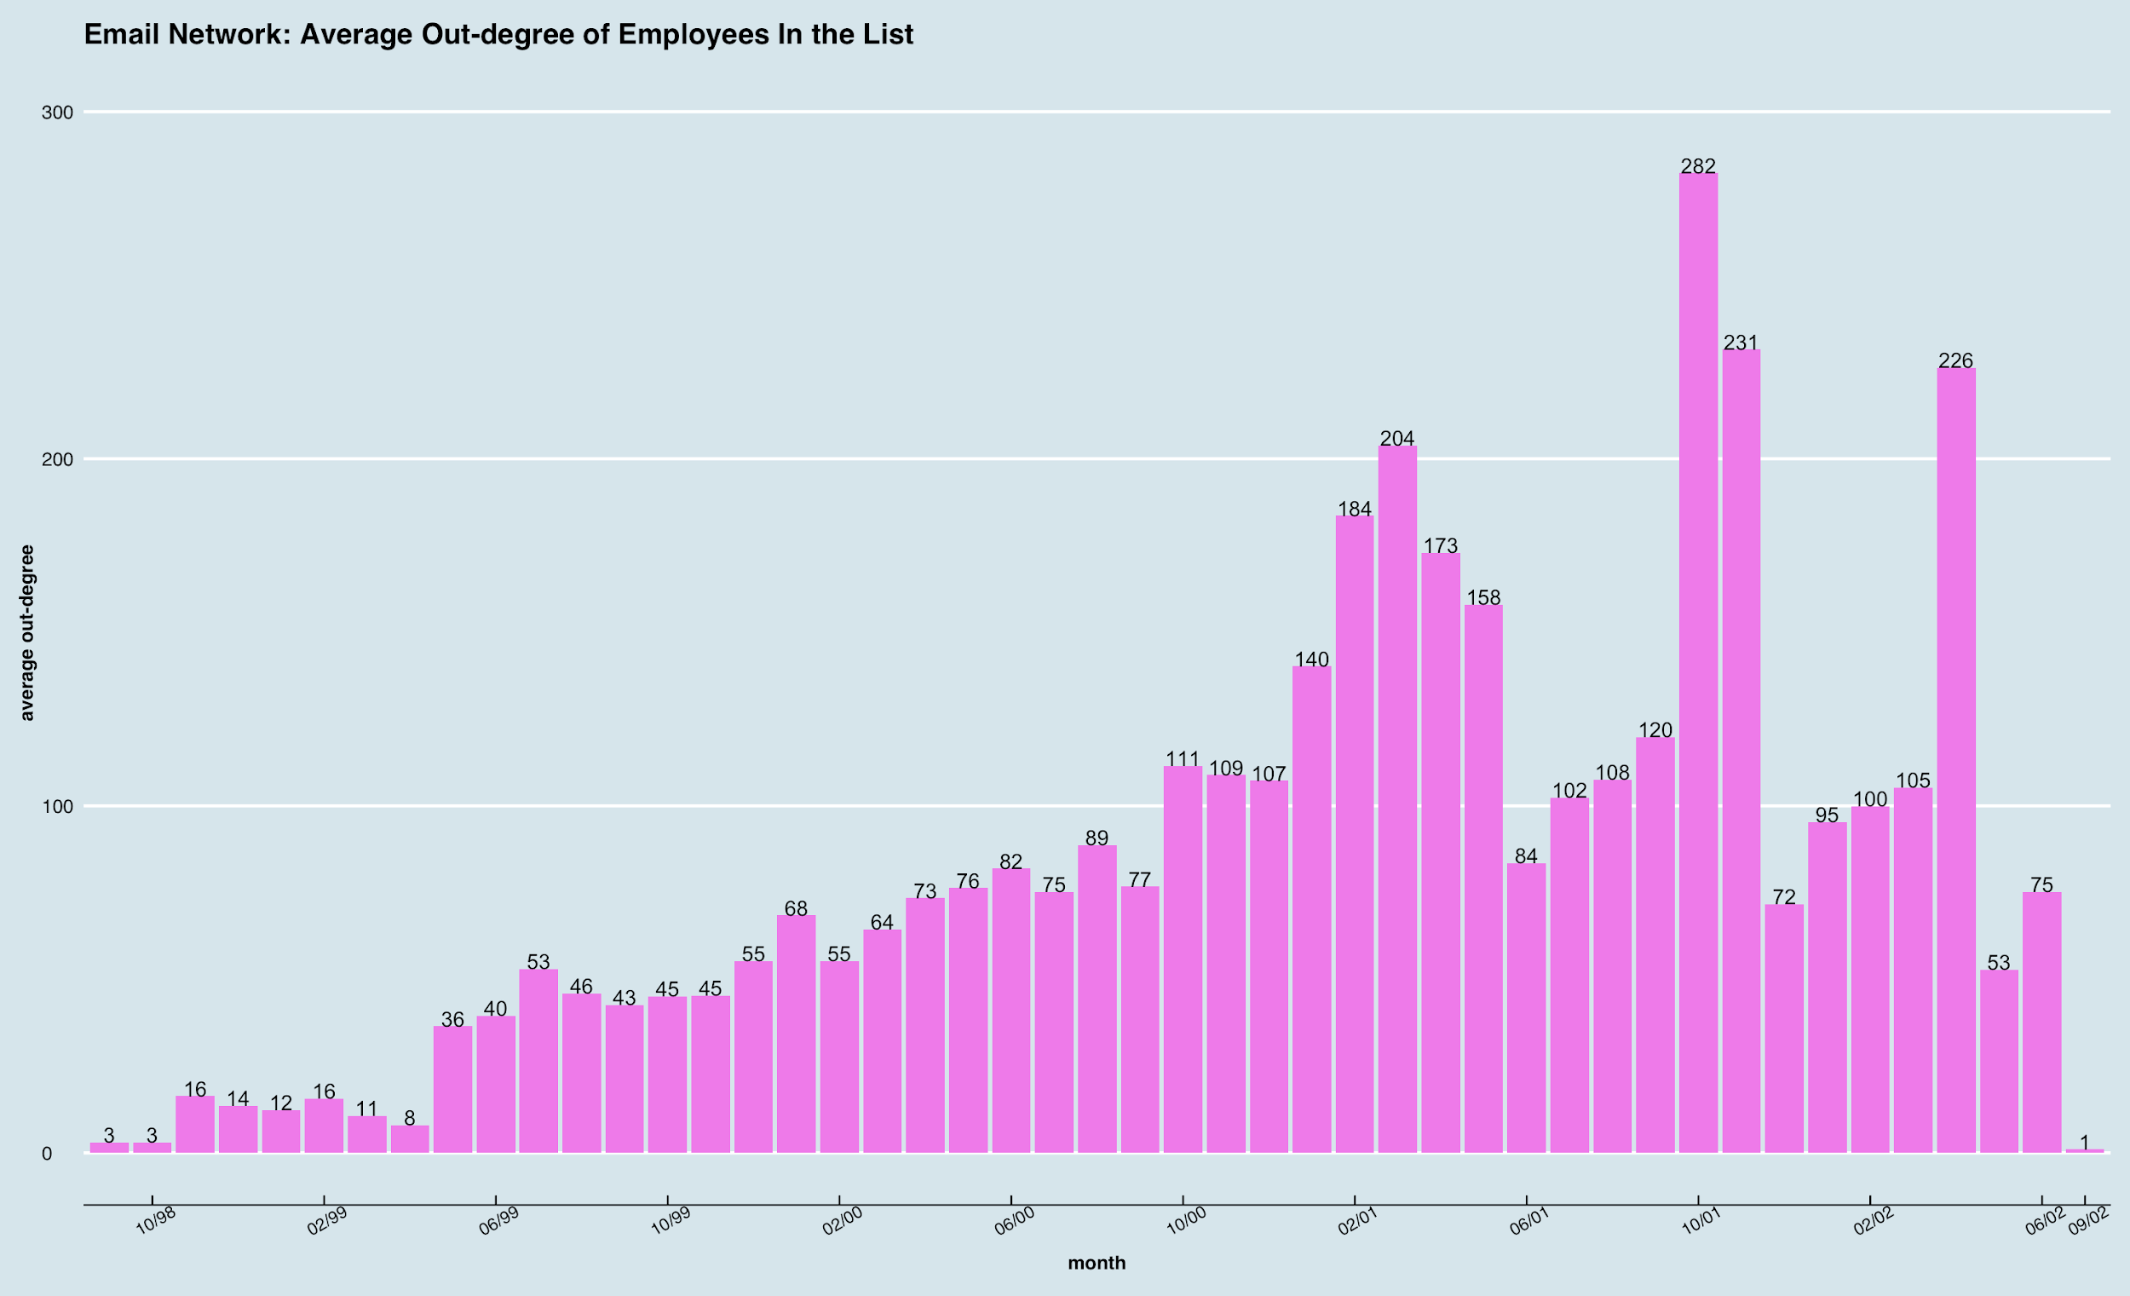
Descriptive Analysis for People “in the List” -- Average Degree & Betweenness
In-Degree
Out-Degree
In-degree, Out-degree, and Betweenness basically reflect the same trend of the network
These three measures constantly climbed during the period leading up to the scandal got exposed, finally reached the peak at the month of exposure (October 2001), and drastically decreased afterwards
Higher activeness and intenser controlling of information indicated
Betweenness

Slide 16
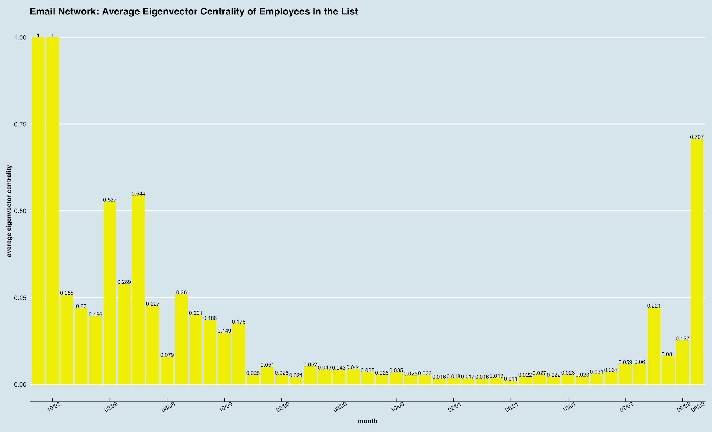
Descriptive Analysis for People “in the List” -- Average Eigenvector Centrality

Slide 17
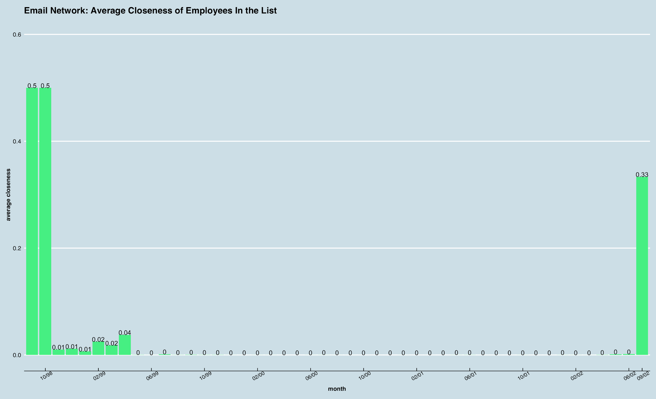
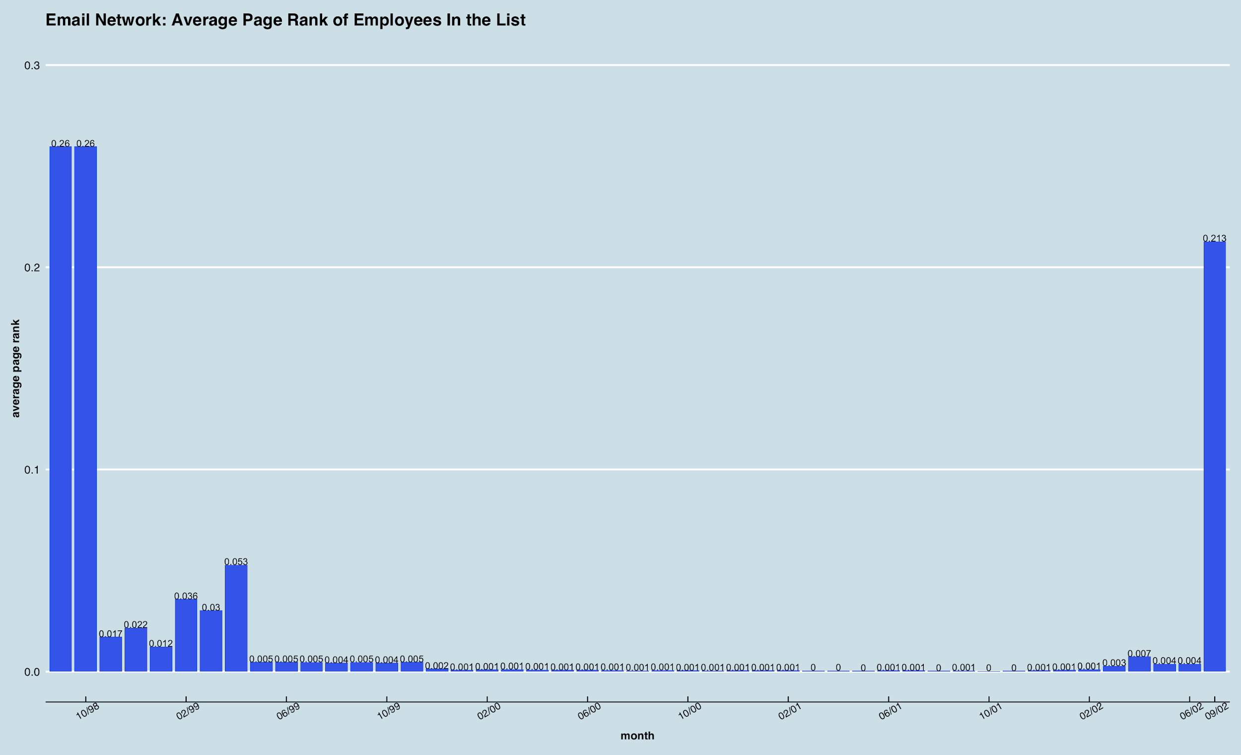
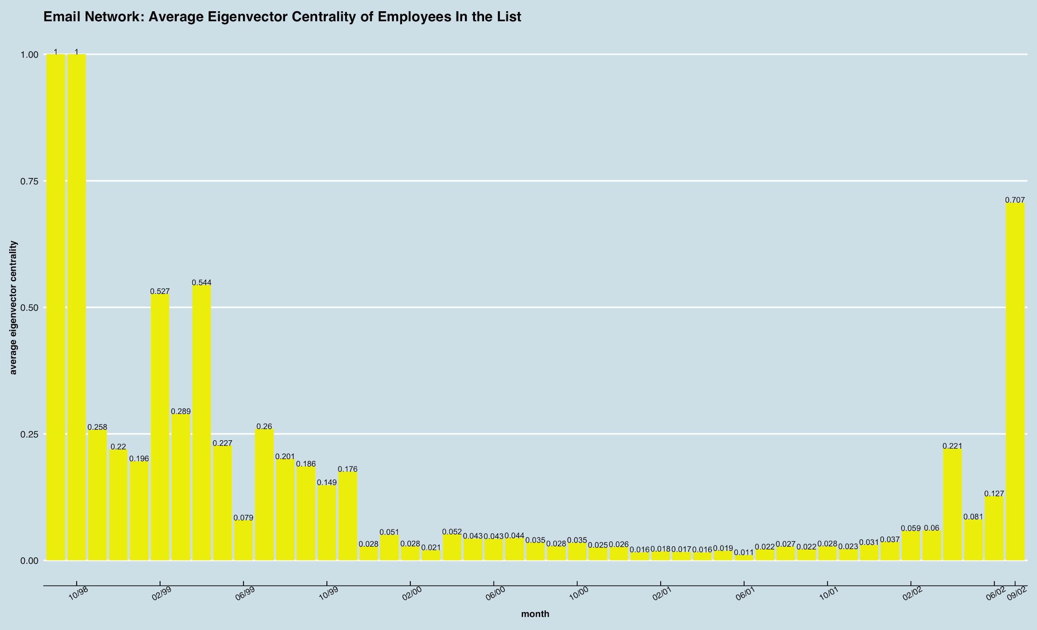
Descriptive Analysis for People “in the List” -- Average Closeness, Page Rank & Eigenvector Centrality
Closeness
Page Rank
Closeness, Page Rank, and Eigenvector centrality basically reflect the same trend of the network
These three measures presented their highest value during the beginning and ending periods of our data, but interestingly displayed a fairly “quiet” period in the middle (also during the period leading up to the exposure of the scandal)
Weaker intimacy and influence of people on the list during the long interim period indicated
Eigenvector Centrality

Slide 18
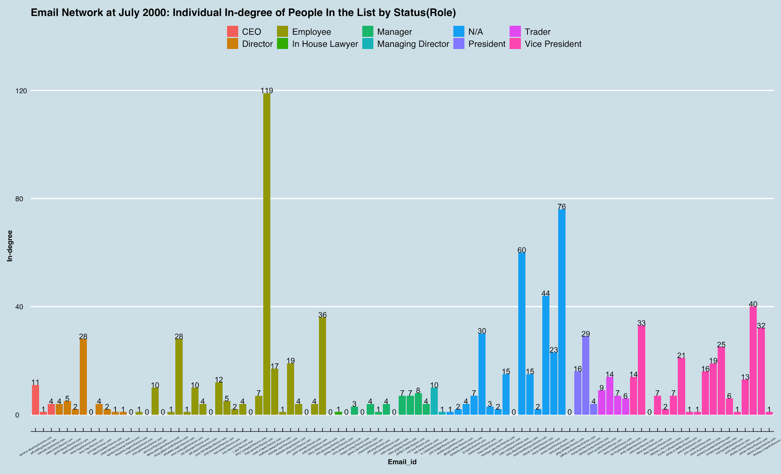
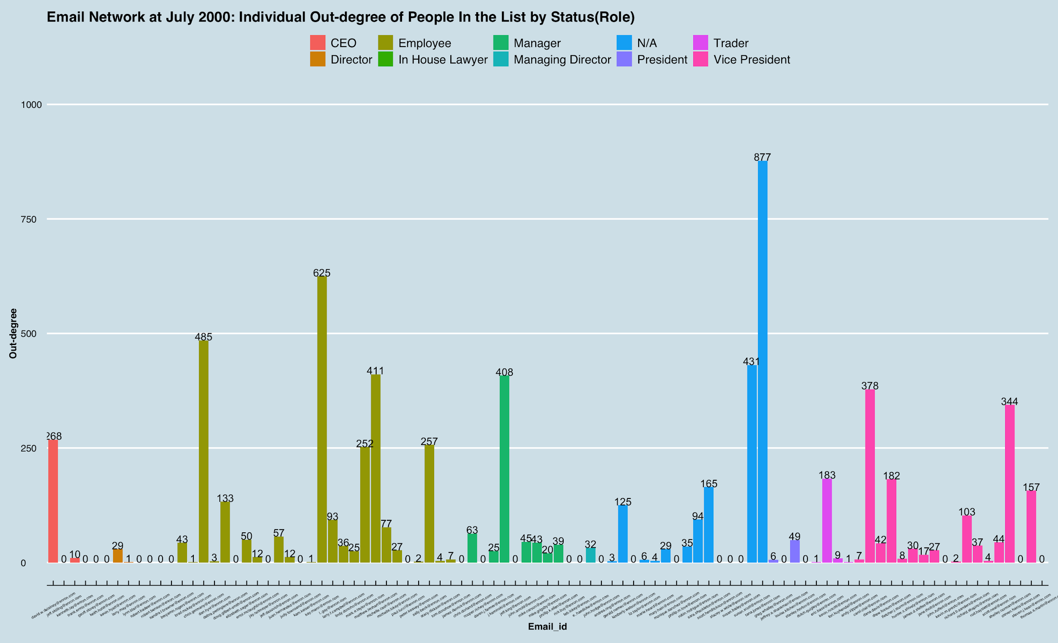
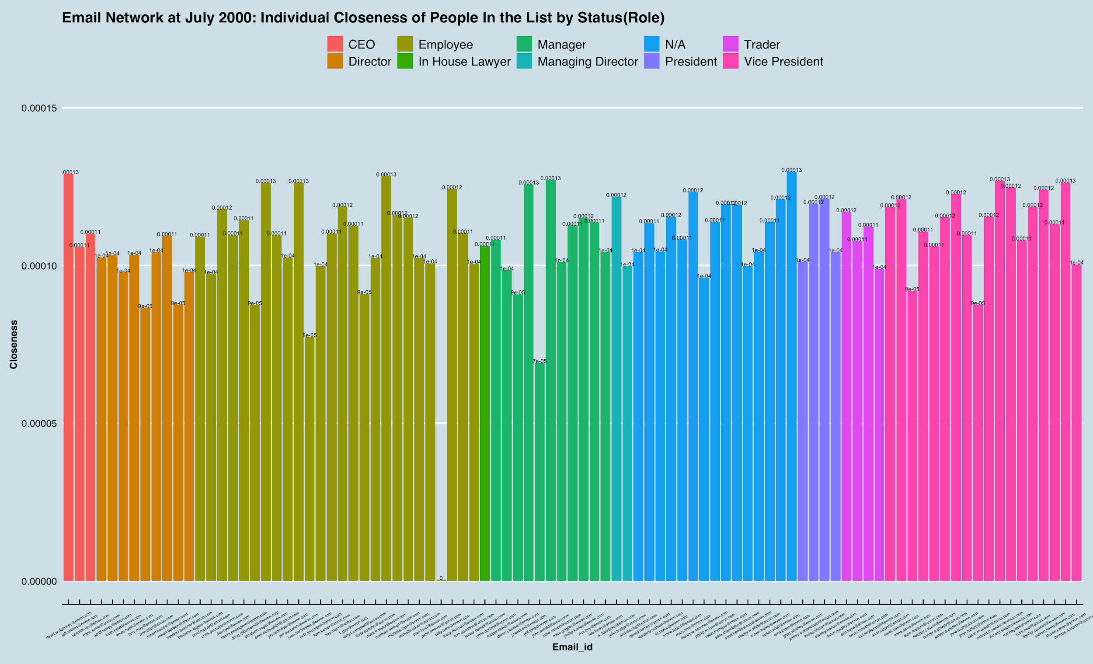
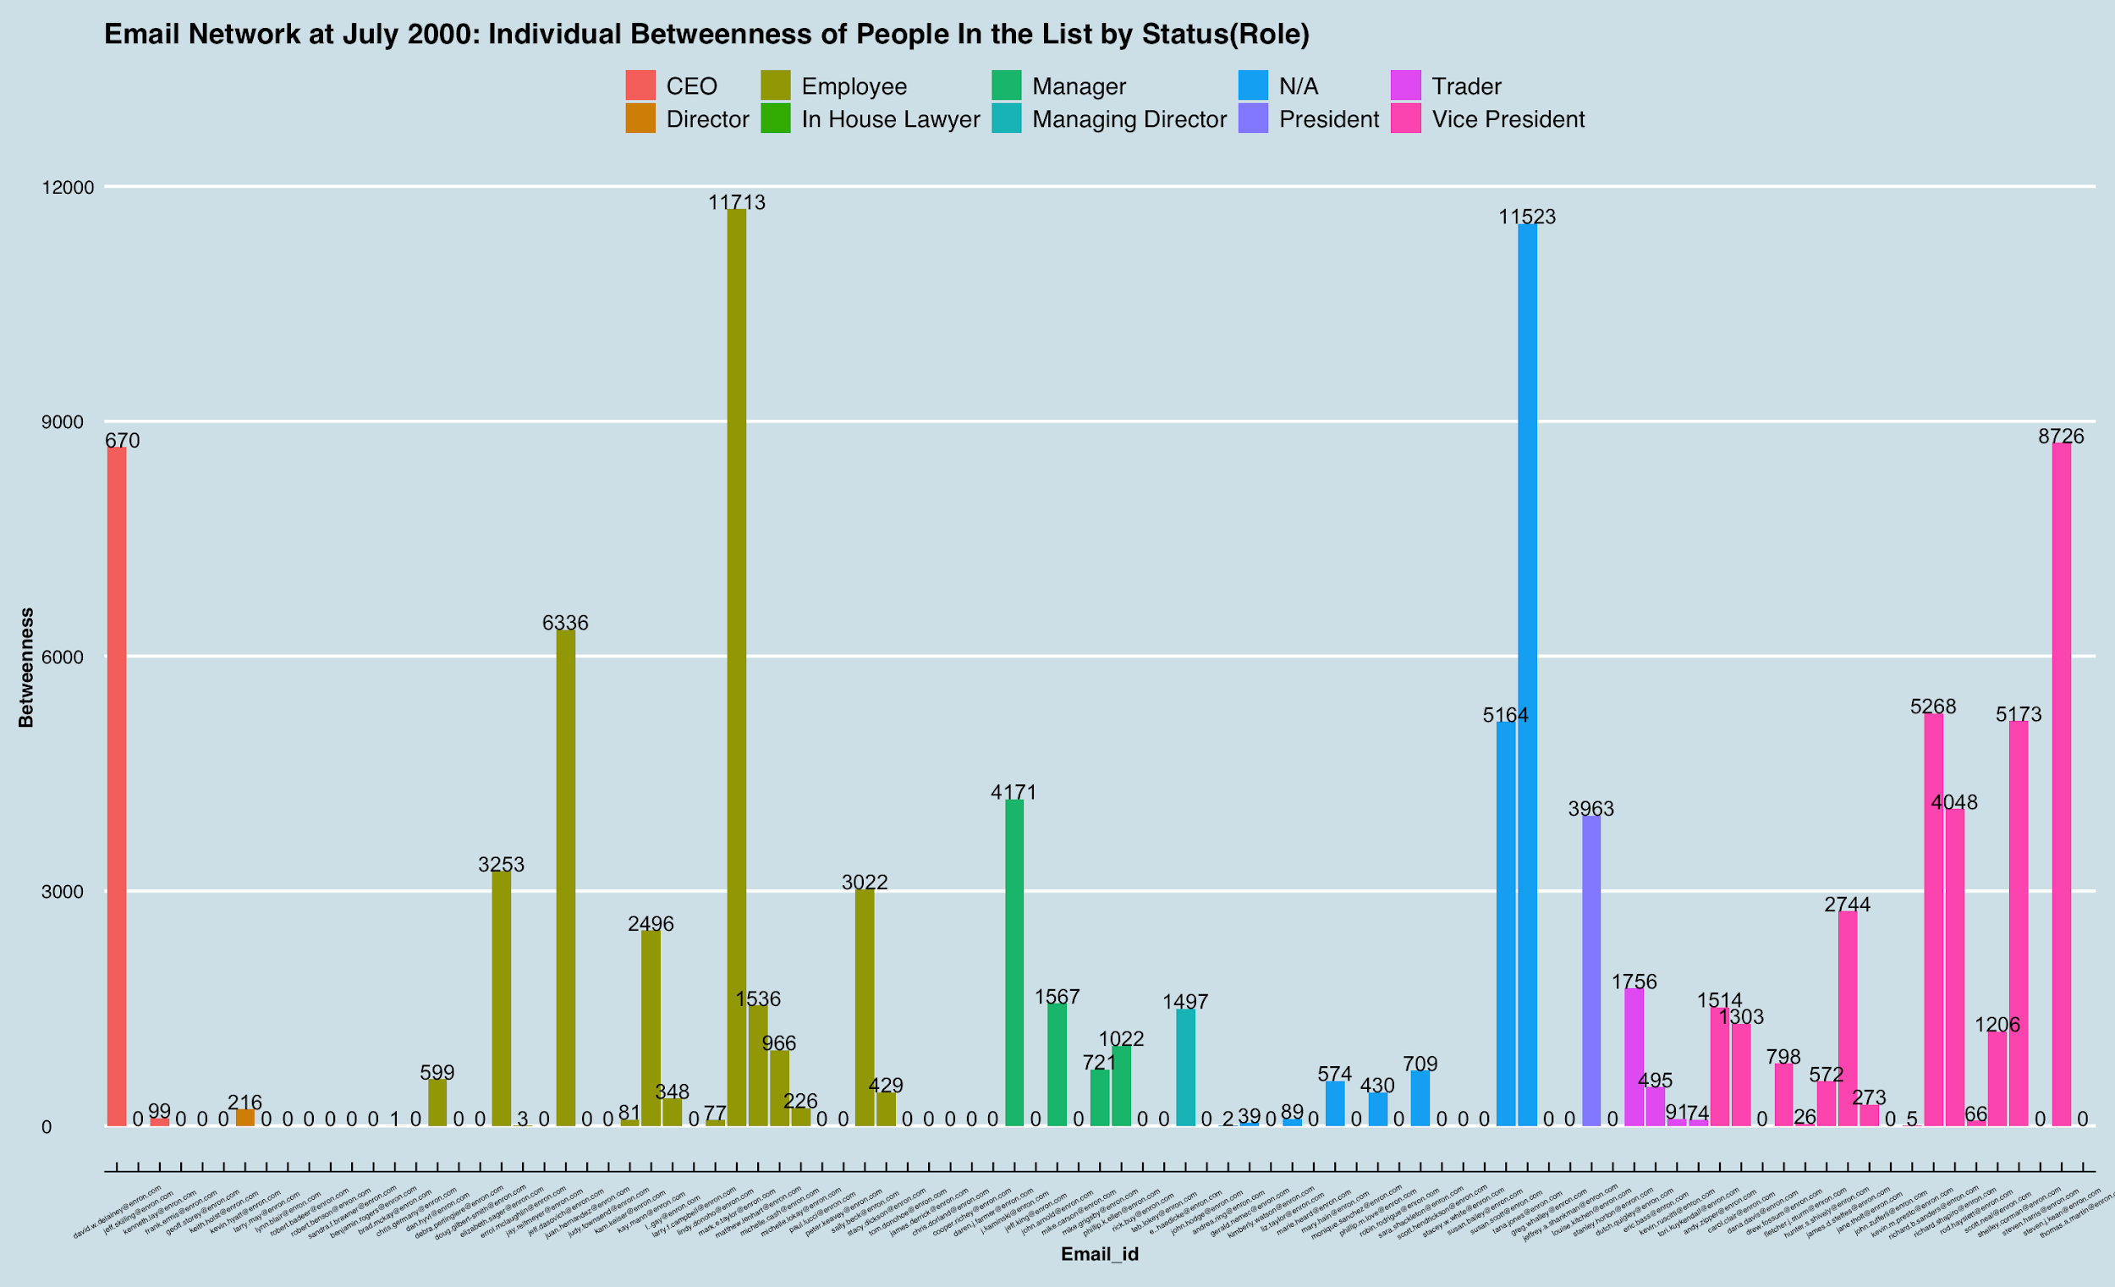
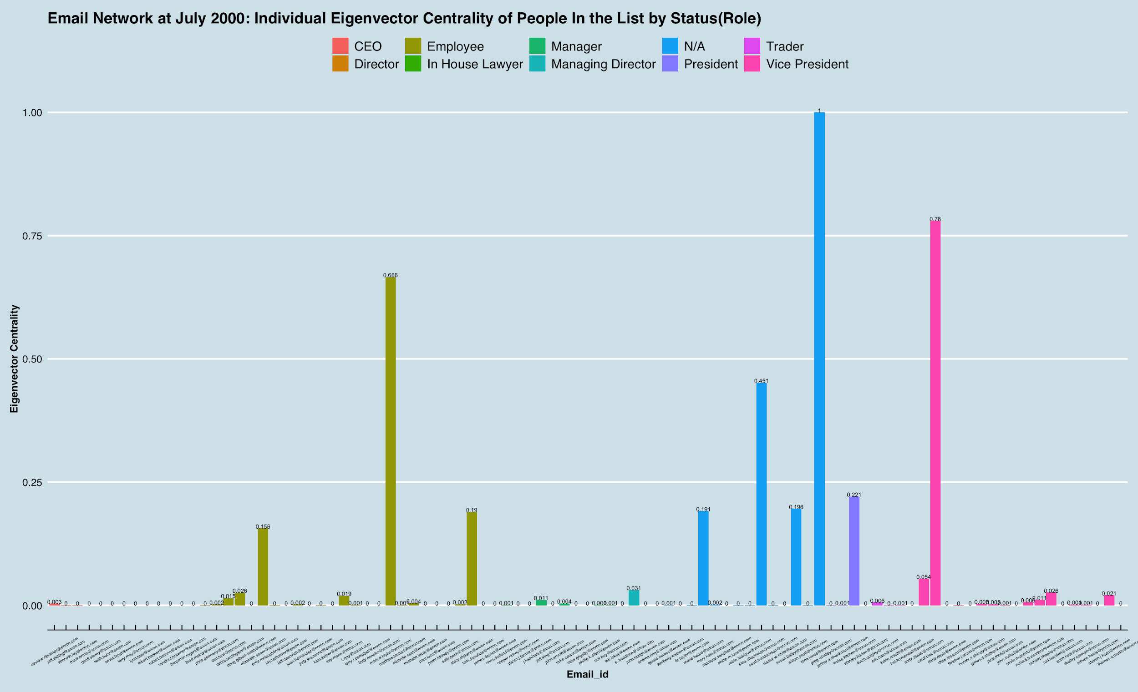
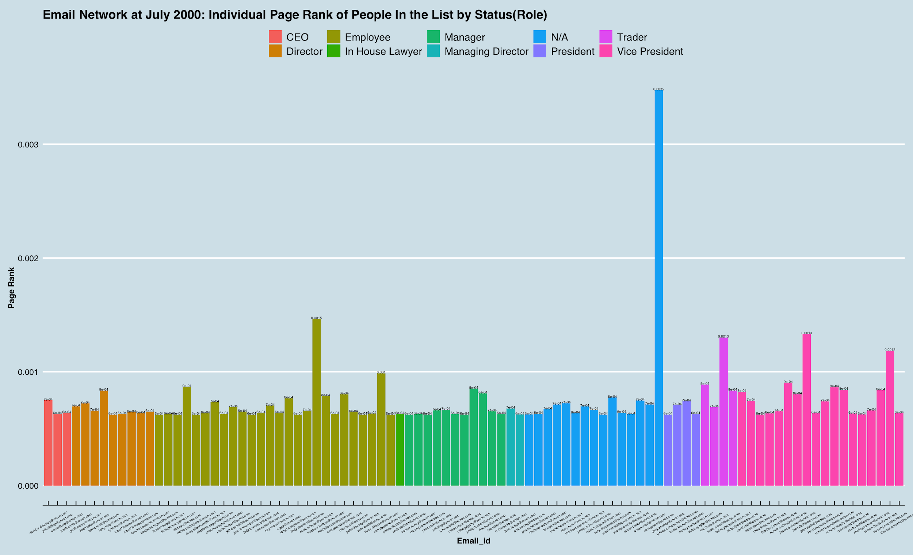
Snapshot for People “in the List” by Role -- “Prime Days”: July 2000
In Degree
Out Degree
Closeness
Betweenness
Eigenvector Centrality
Page Rank
Notes:
-In this special list of people in Enron, during this steady and prosperous of December 1998, it seems like the type of people with the role of “employee” and “other” role in our data have a stronger presence in basically all measures here--they have a higher in- and out-degree, betweenness, eigenvector and page rank centrality than any other type of people.
-For “closeness” which features distances among actors and “page rank” featuring influences (except for “other” role), there are relatively smaller differences across different types of people than the other measures, and the magnitudes are very small as well.
-Note the magnitude of betweenness is very huge.

Slide 19
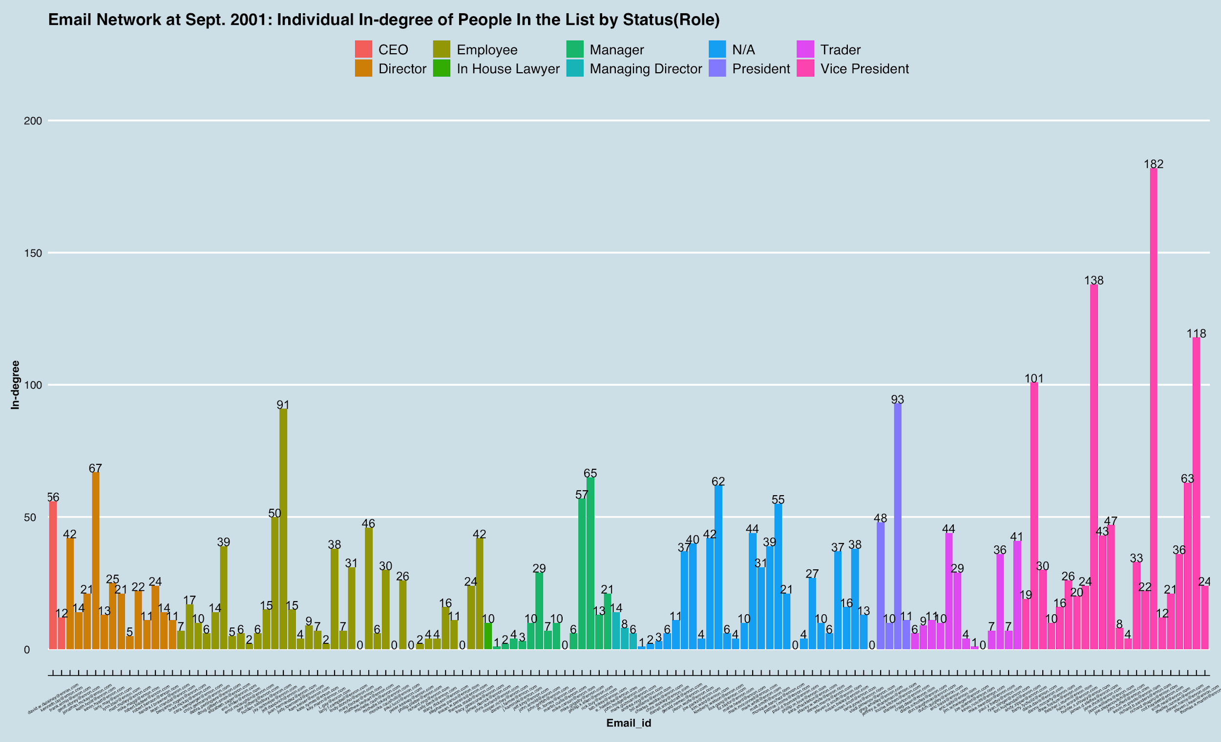
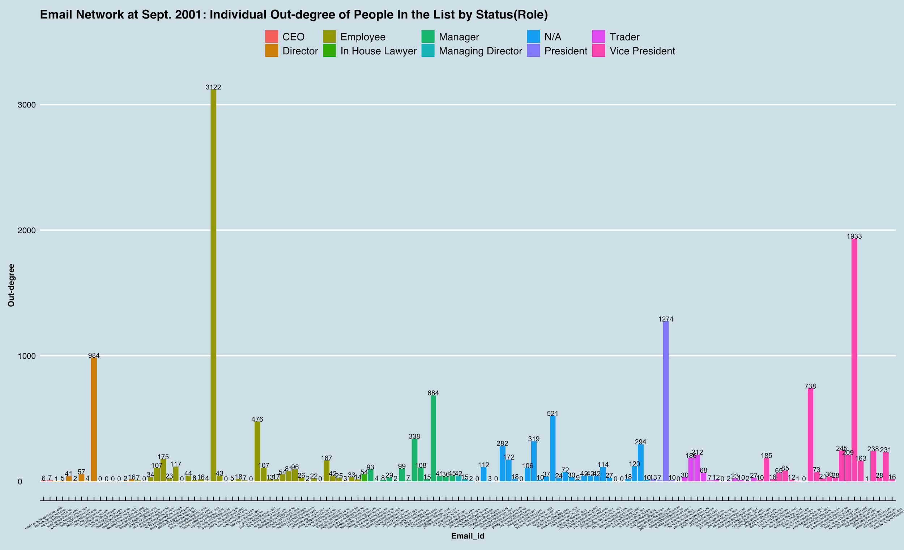
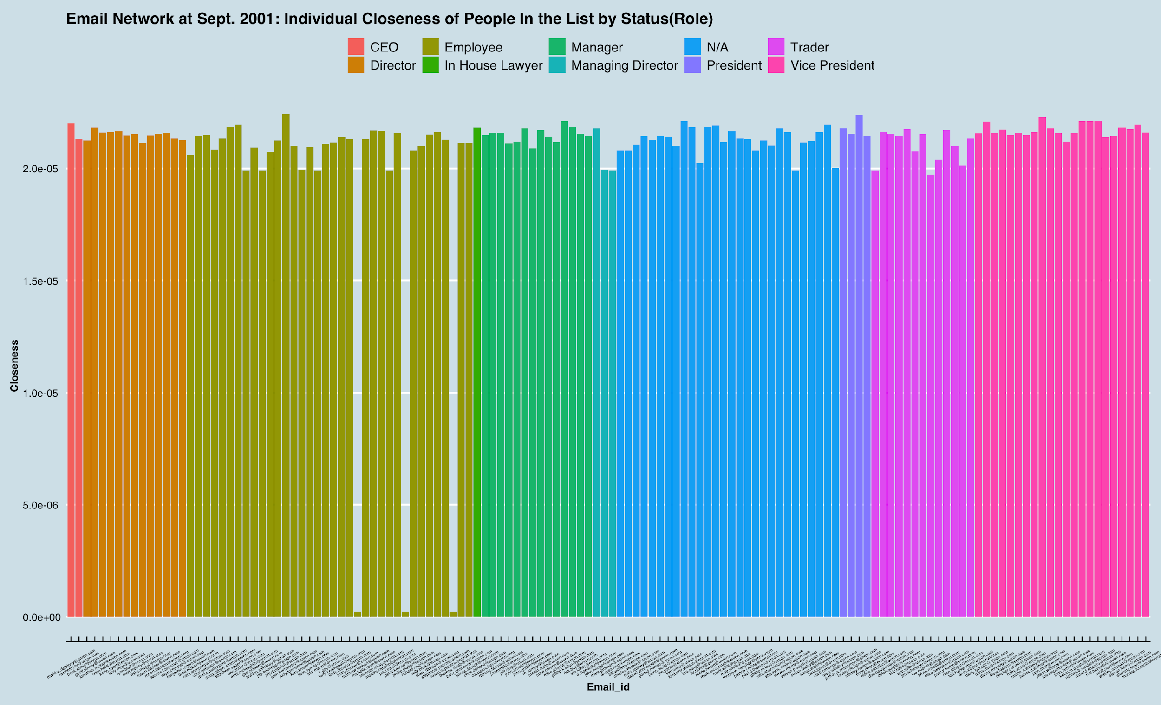
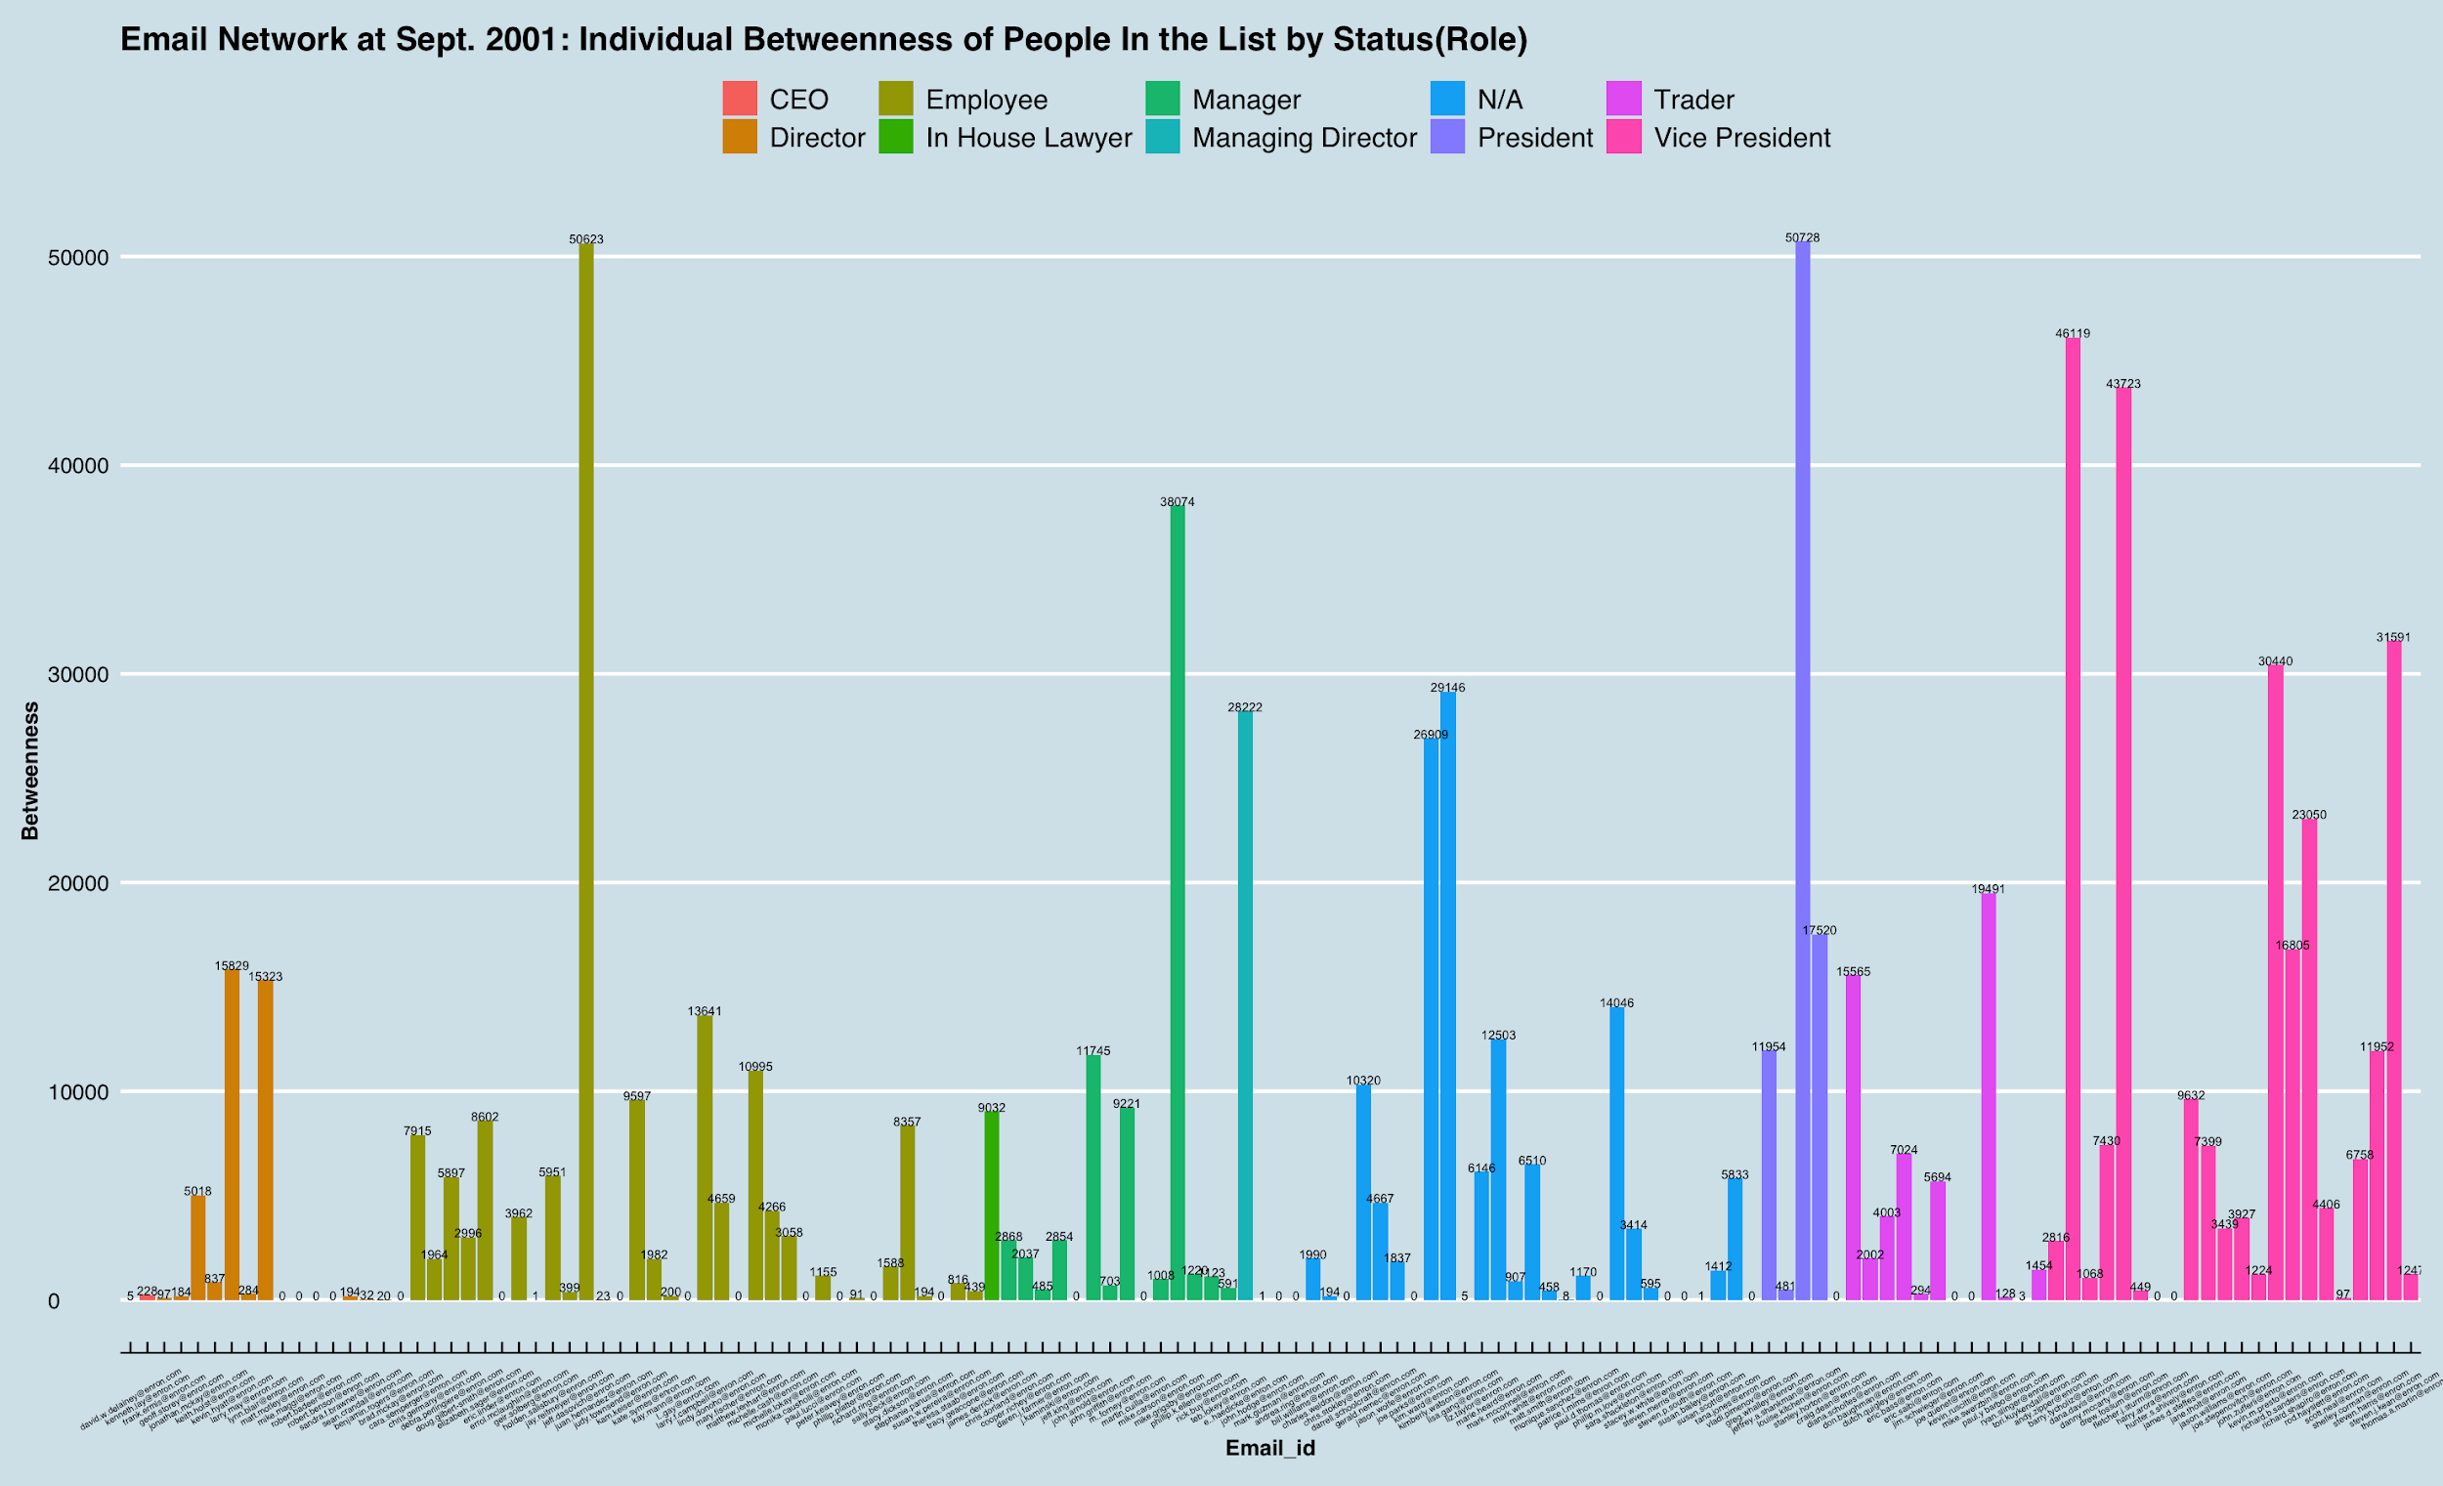
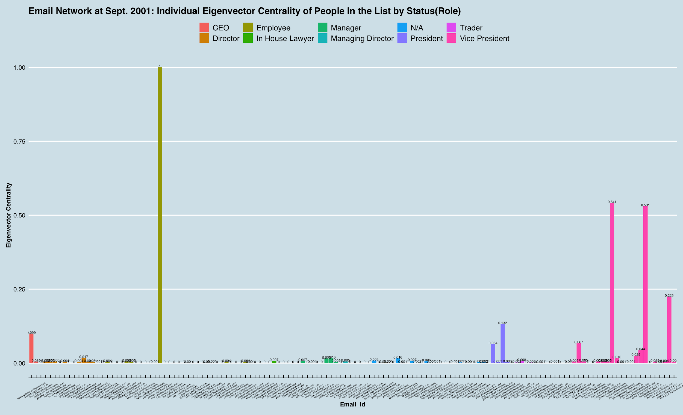
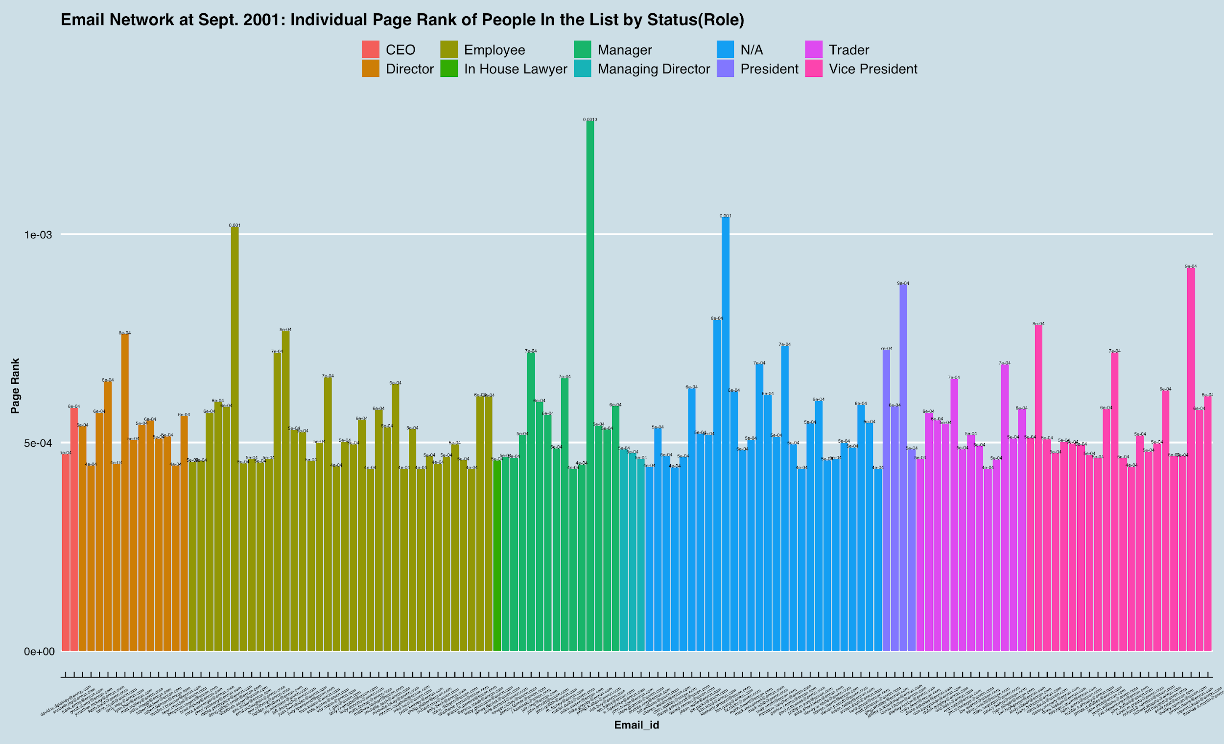
Snapshot for People “in the List” by Role -- Crisis “in the air”: September 2001
In Degree
Out Degree
Closeness
Betweenness
Eigenvector Centrality
Page Rank
Notes:
-During this ”Vice president” type stands out with regard to “in-degree” and “betweenness” centrality, indicating more outgoing activities and influence to be intended on other types of people.
-Compared to previous steady and prosperous time, this period of sensing the crisis in the “air” witness a even smaller closeness and page rank of those people in the list, suggesting a farther distance and influence interpersonally → people seem like to be more separated with others

Slide 20
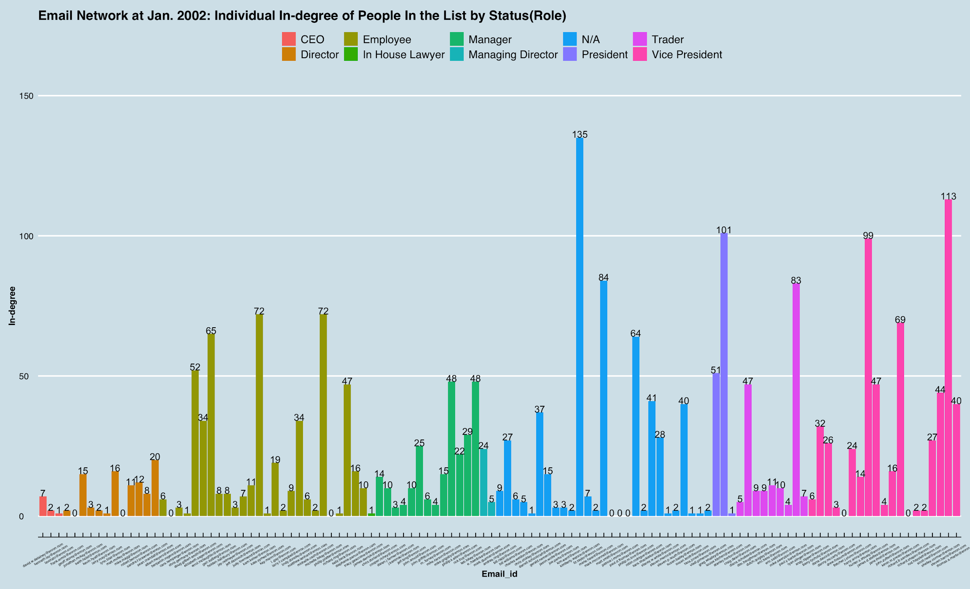
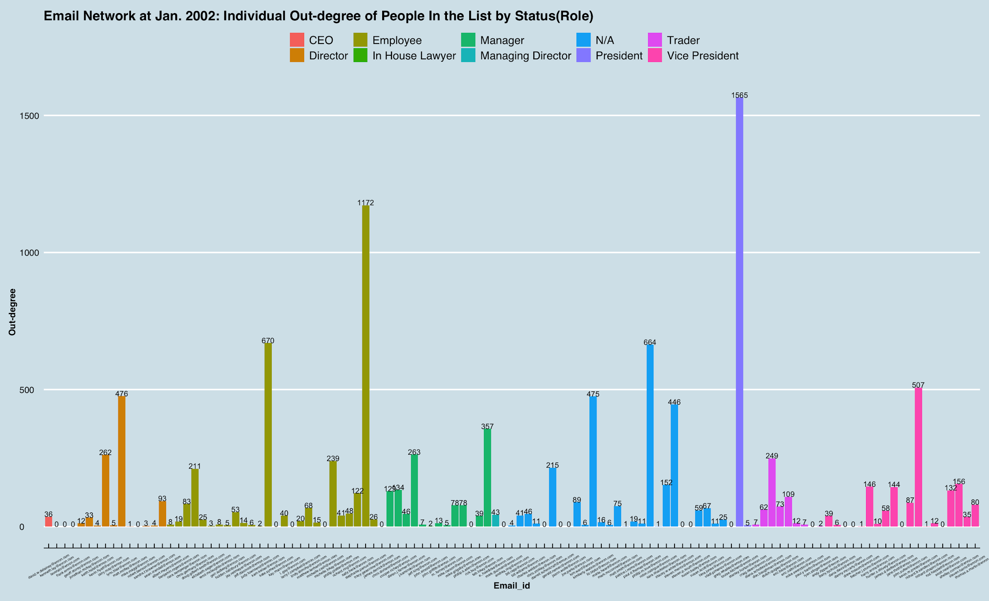
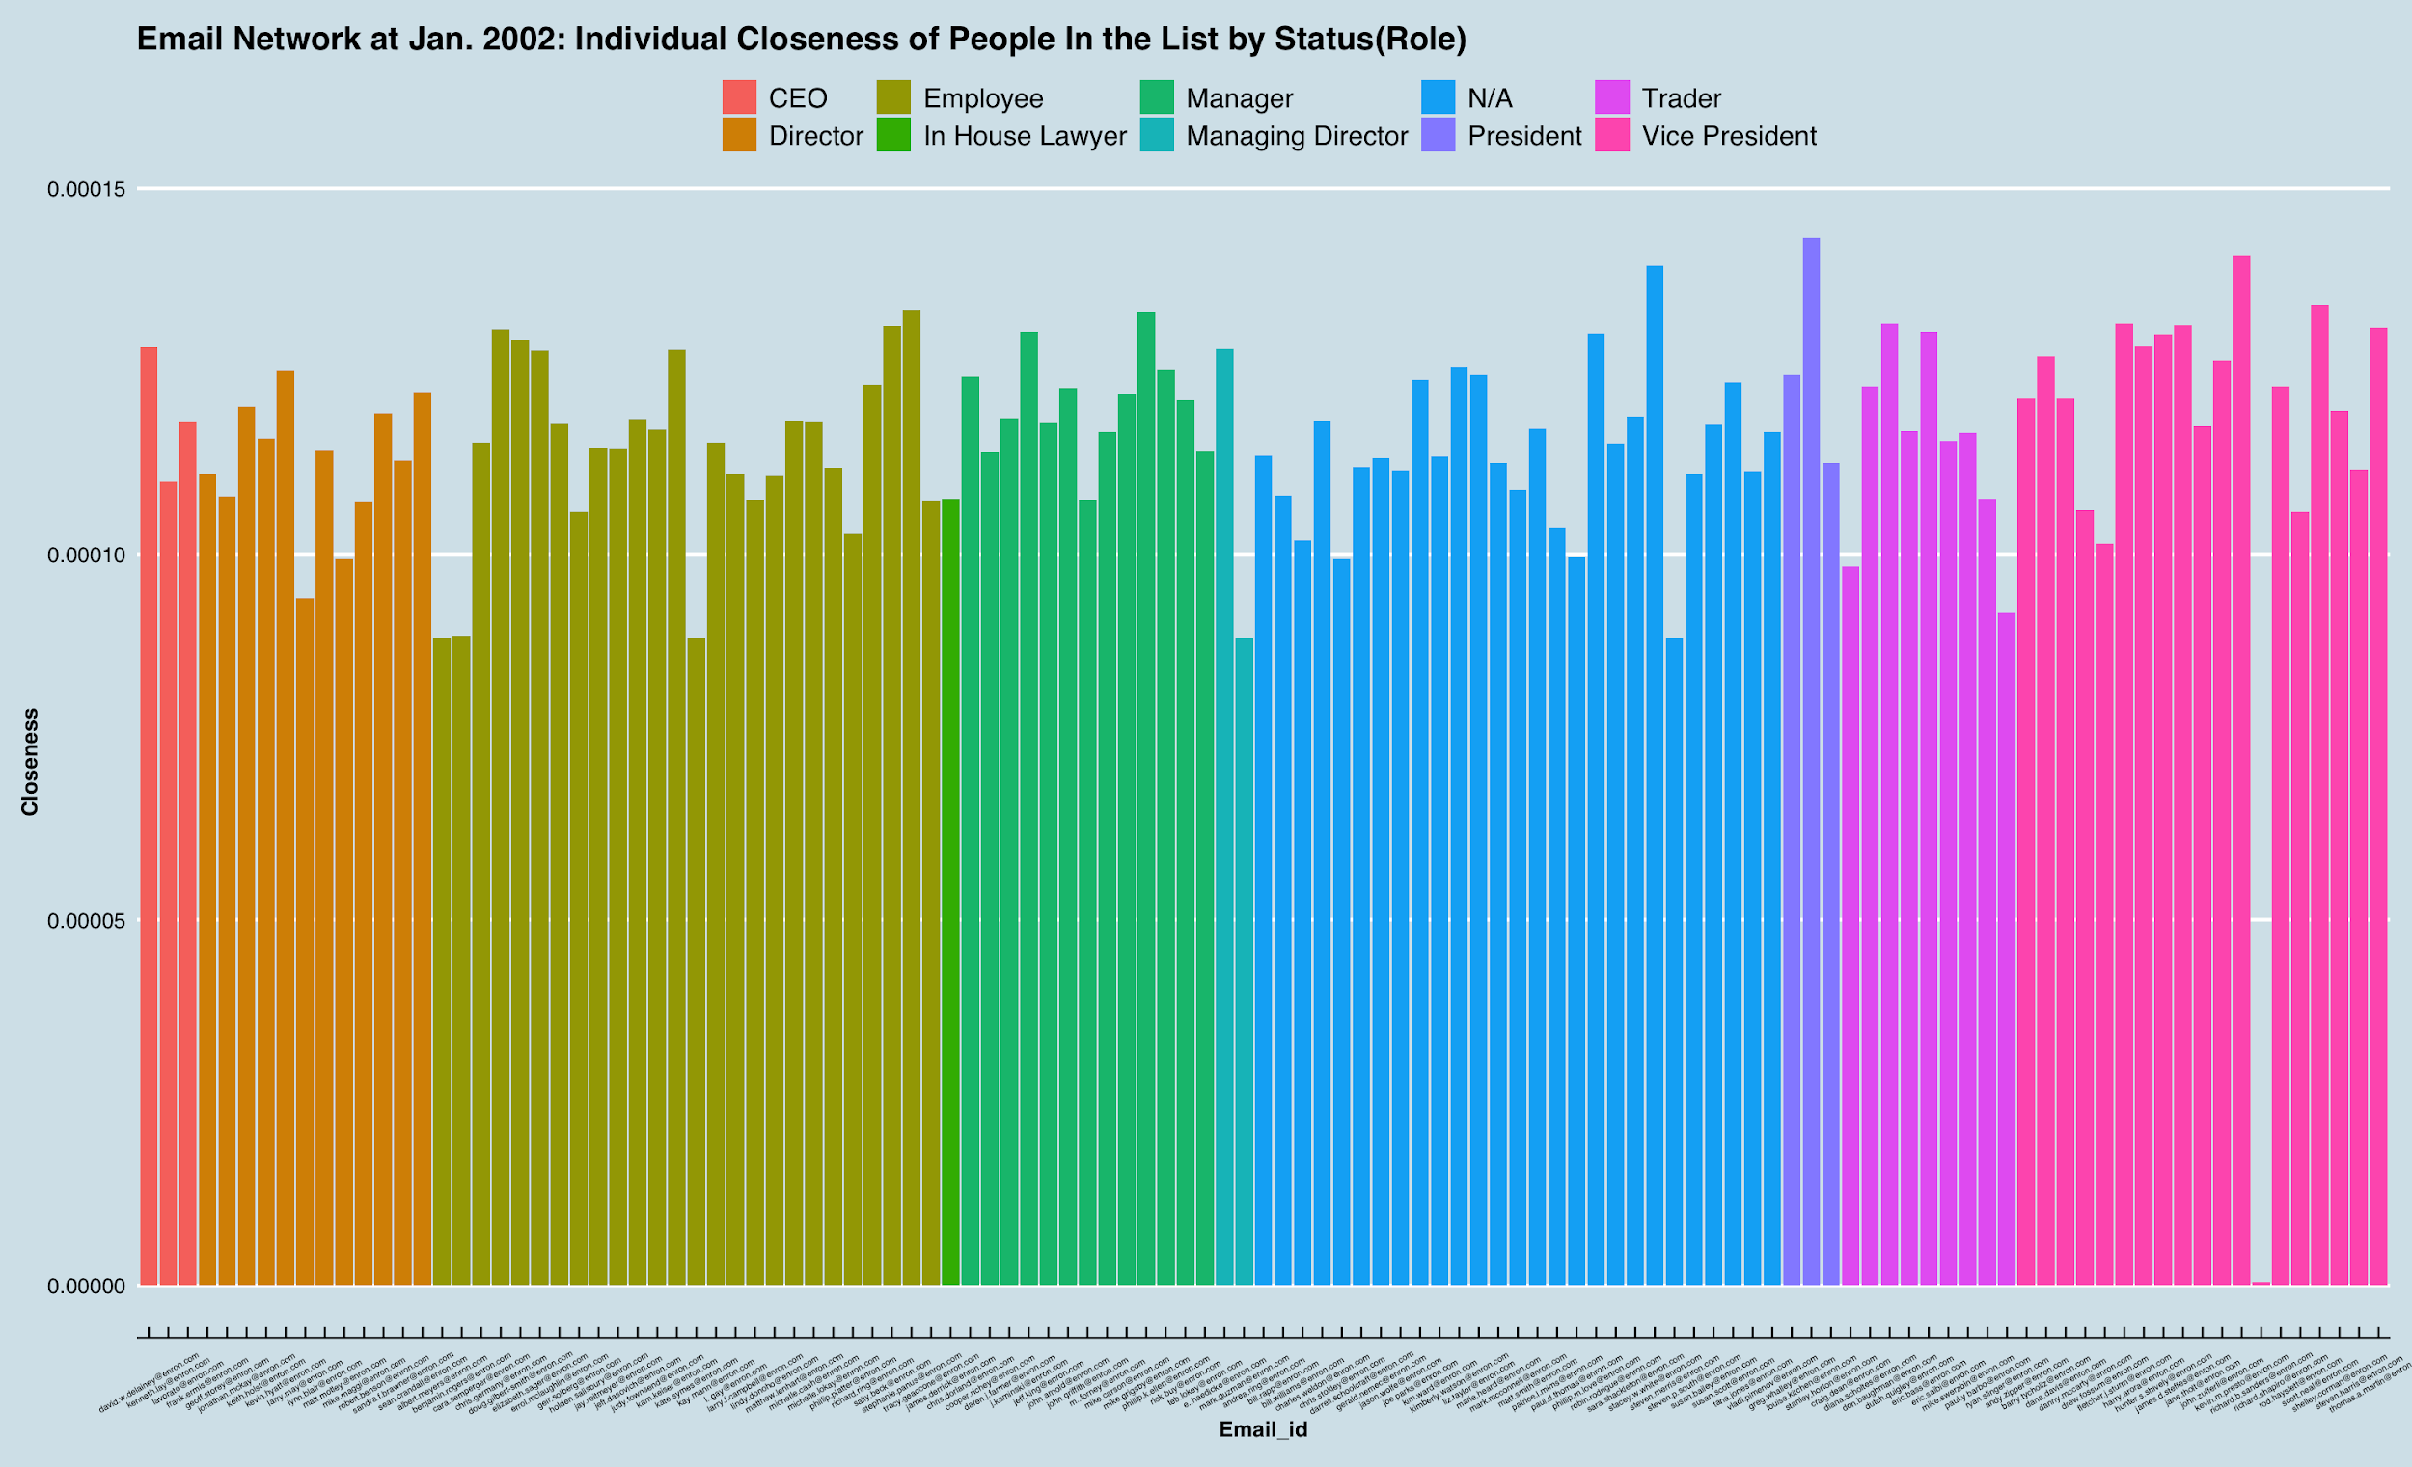
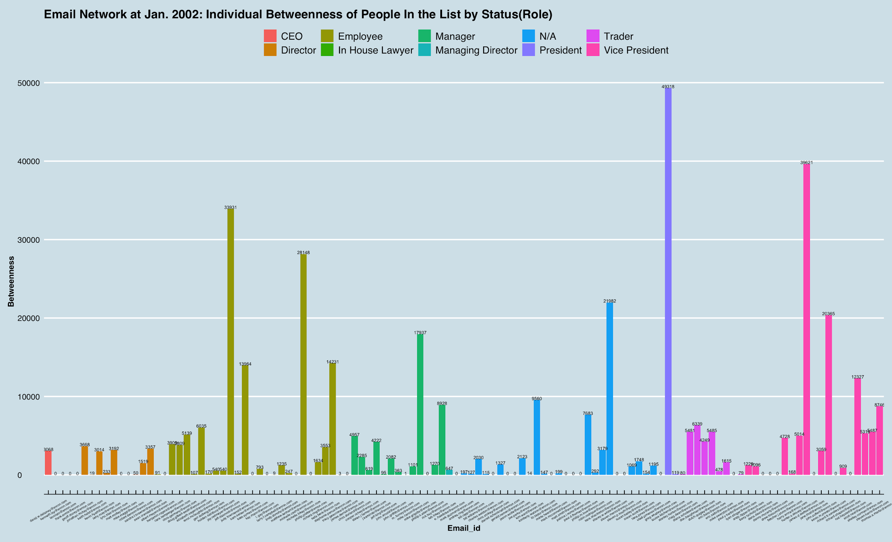
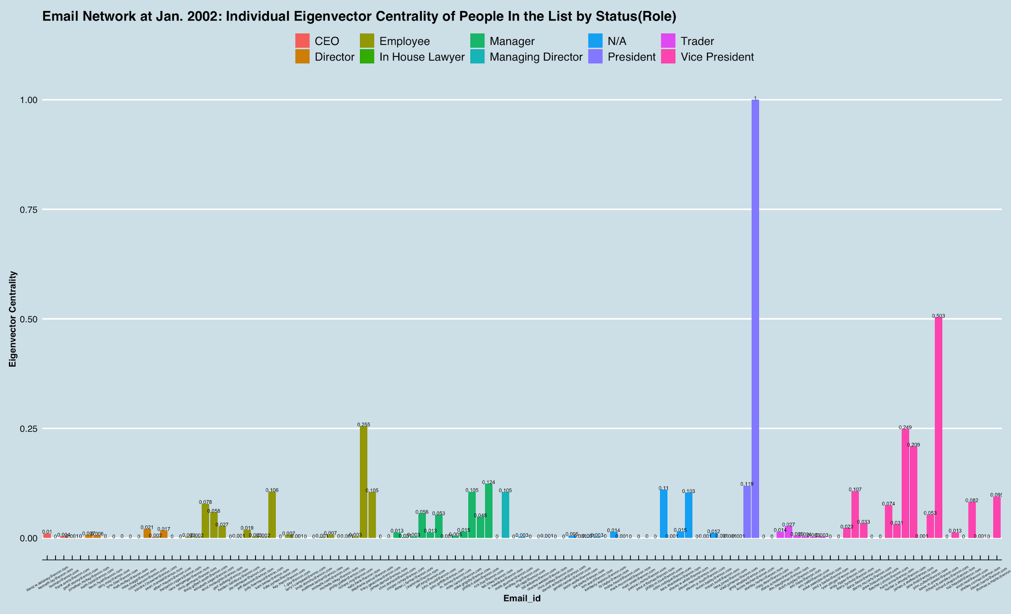
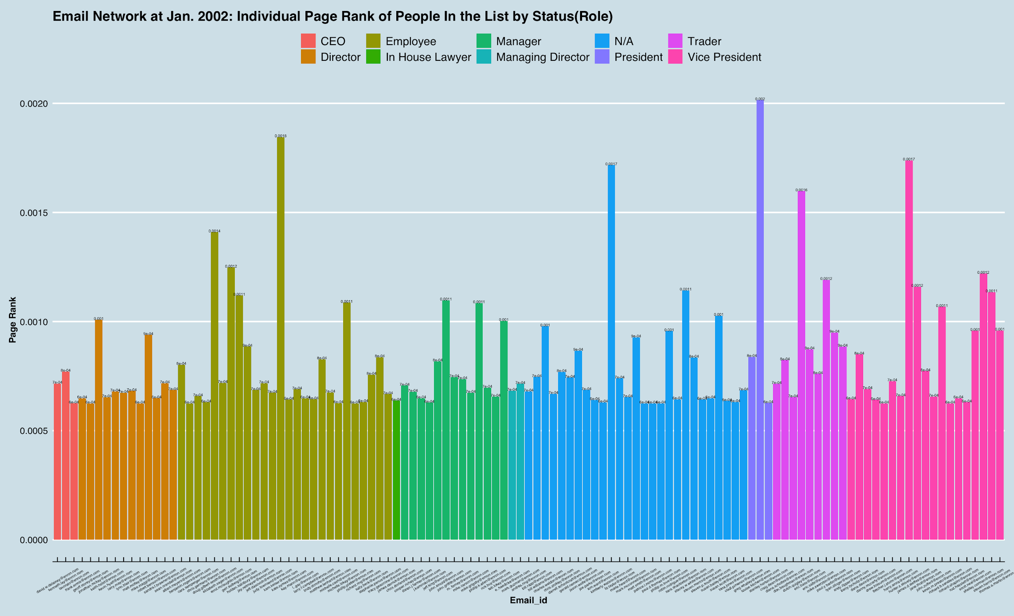
Snapshot for People “in the List” by Role -- After Bankruptcy: January 2002
In Degree
Out Degree
Closeness
Betweenness
Eigenvector Centrality
Page Rank
Notes:
After the enormous scandal got revealed to the public and Enron finally filed for bankruptcy, the graphs of these six measures seemed something like a blend of those during the prosperous period and period right before the exposure -- “employee” and “other” types of people got a little more active and influence than the period right before the exposure, while the “President” “Vice President” type of people remained relatively active and continue playing the role of information and control brokerage.
--*more: a little bit introduce to those senior management members -- they are all found guilty to a relatively bigger degree later [e.g.: Louise Kitchen (Head of Energy Trading division), other involved in serious Insider Trading,...]

Slide 21
Interesting Findings
Before the crisis | After the crisis
People communicate via email frequently | People dramatically reduce their communication via email
Most of the people are part of a certain group | Most of the people tend to be isolated. Only a few groups remain
Amount of bcc emails are normal | Amount of bcc emails skyrocketed
“Employee” and “other” type of people in the list took control and remained active generally in steady times | “President” and “Vice President” type presented higher-than-usual activeness and brokerage role

Slide 22
Less email - People have changed to other form of communication (e.g. face-to-face)
More isolation - People want to keep a lower profile
More BCC - People do not want their email recipients to see each other (send out ‘secret emails’)
Conclusion
After the crisis...

Slide 23
Does network analysis help us to figure out who are the origins of wrongdoing in the company?
Highlight and track the key players in the visualized network, and dig deeper into analysis of their data
Regression method to dig deep into the data
Analyse the content of emails
Intended Findings and Future Analysis

Slide 24
Q & A

Slide 25
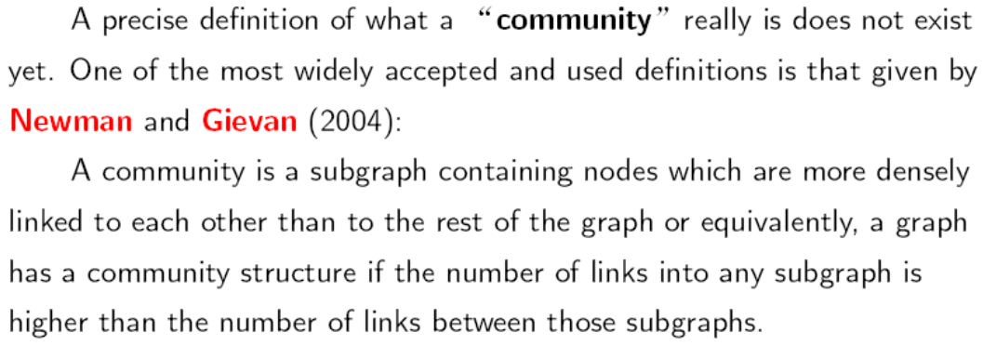
Appendix

Slide 26
Appendix
https://todd-benschneider.com/2015/08/29/enron-collapse-a-case-study-in-audit-failure/

Slide 27
Appendix
https://jrfibonacci.wordpress.com/enron-stock-price-chart-ranking/

Slide 28
Corporate corruption and accounting fraud
America's seventh largest company in 2001
Bankruptcy of Enron and dissolution of Arthur Andersen - nearly 100,000 people lose their jobs
Enron CEO Jeff Skilling was sentenced to 24 years; CFO Andrew Fastow was sentenced to 6 years; Founder and former CEO Kenneth Lay died before serving time
Appendix
Background - The Enron Scandal

Slide 29
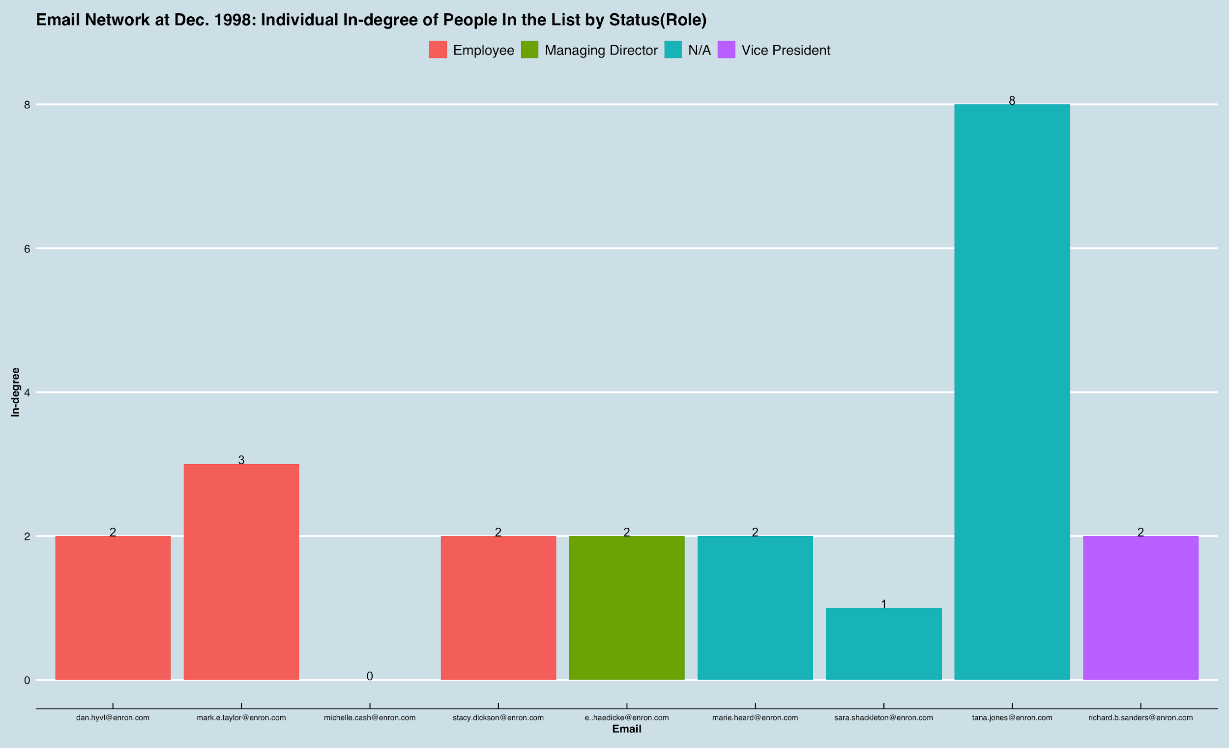
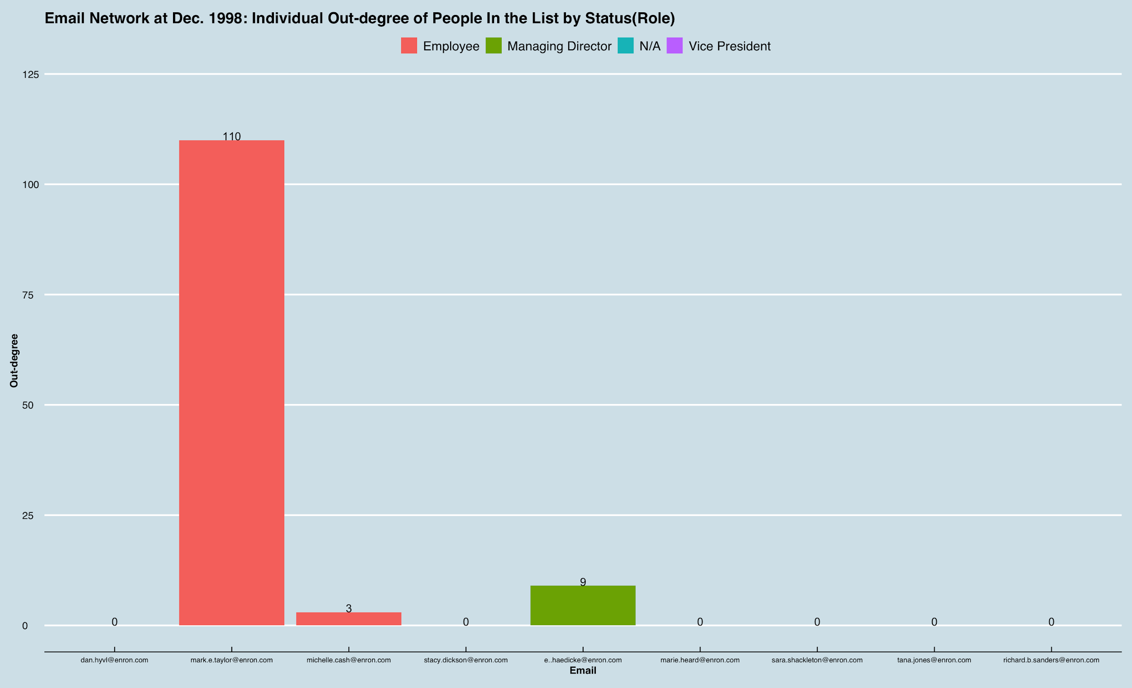
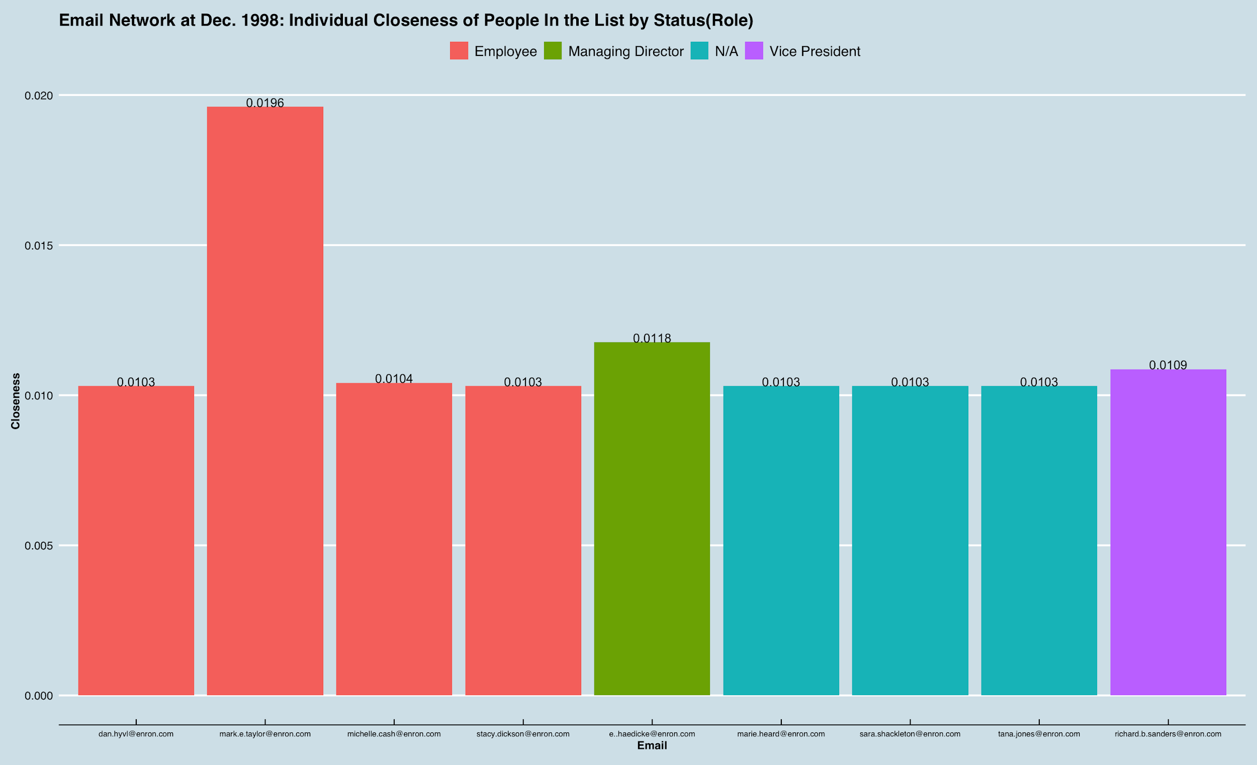
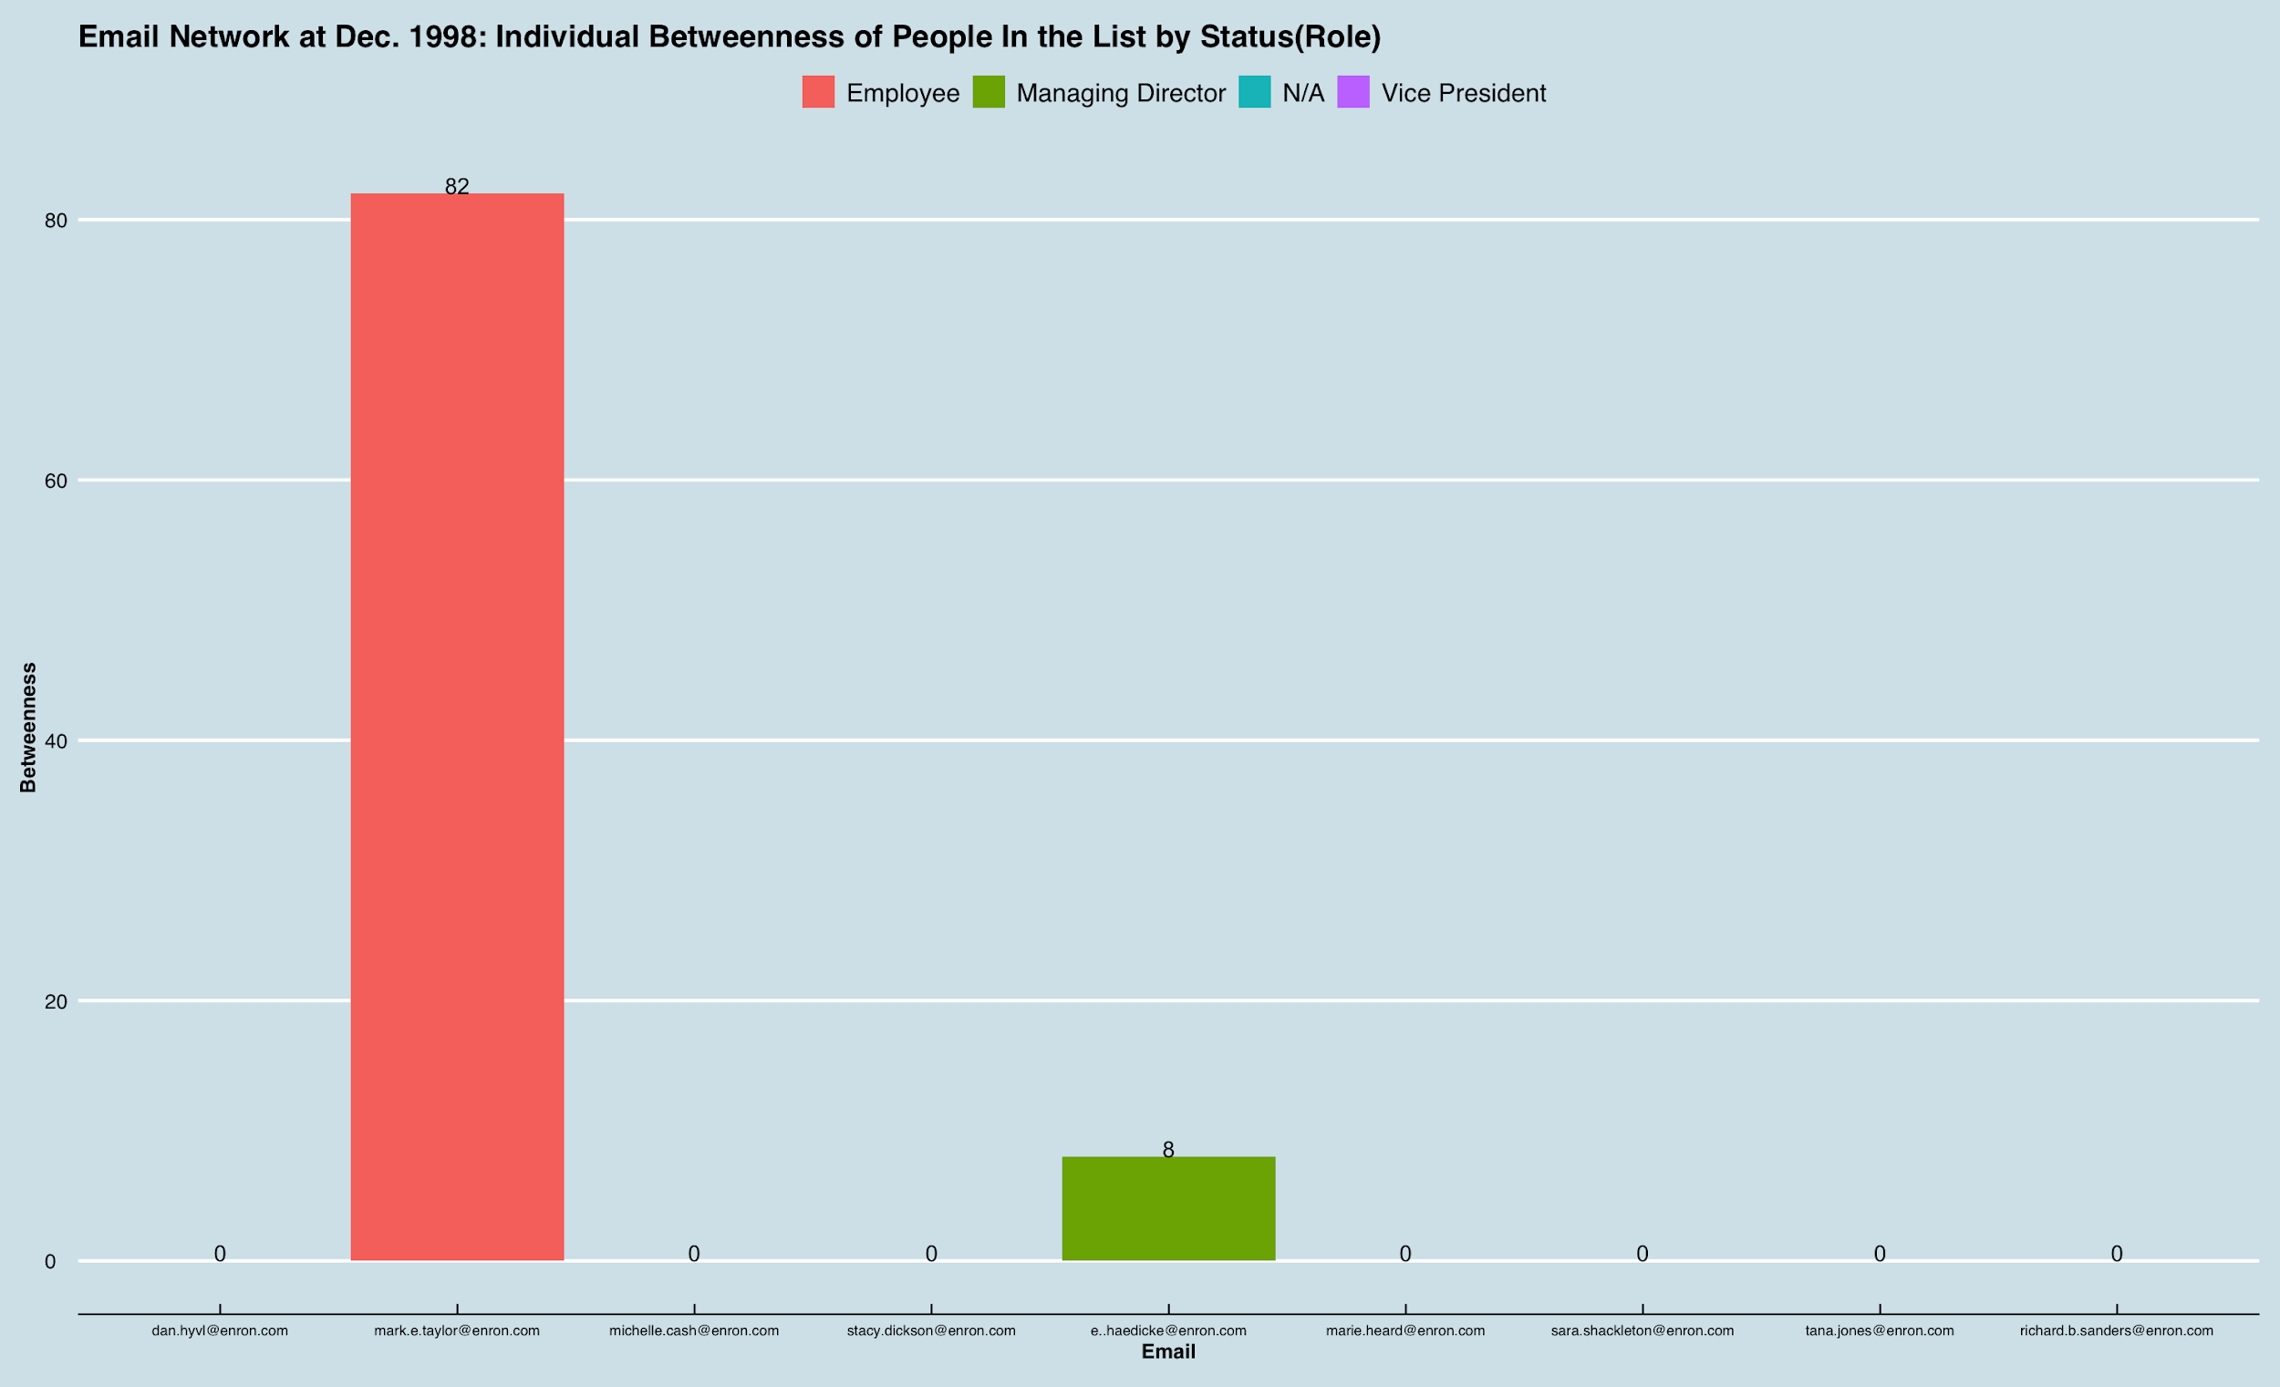
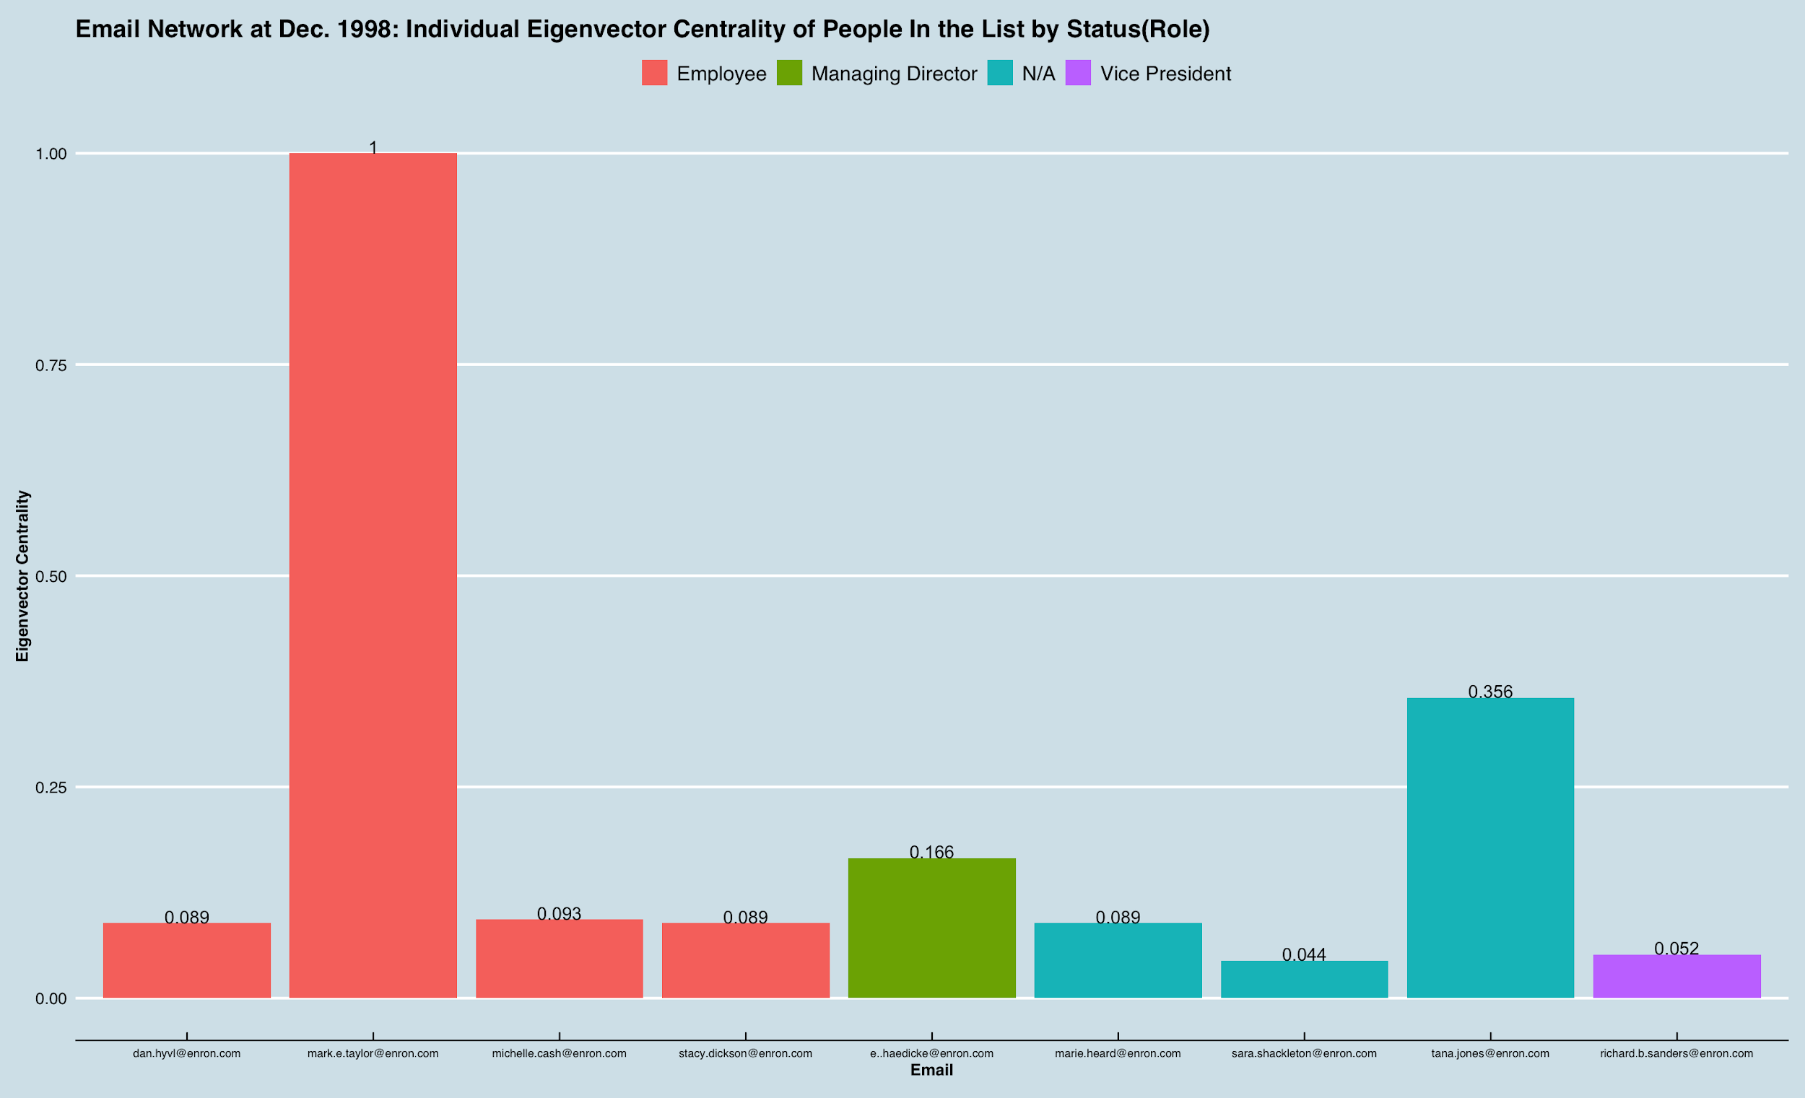
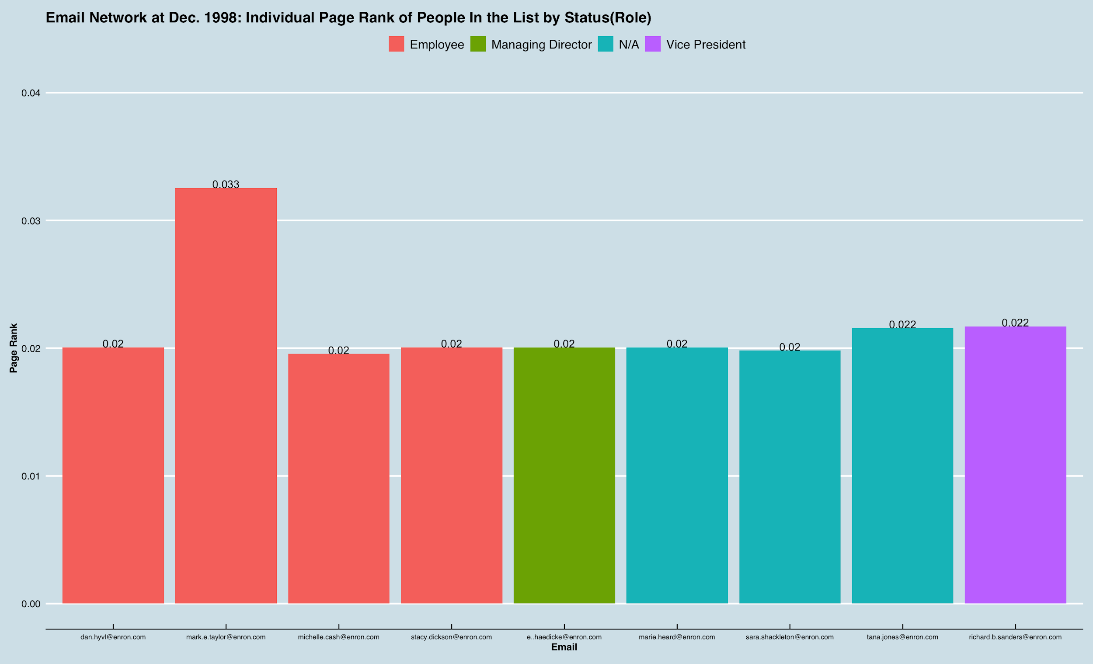
Snapshot for People “in the List” by Role -- Earlier period: December 1998
In Degree
Out Degree
Closeness
Betweenness
Eigenvector Centrality
Page Rank

